Slide 1
SPELD NZ October 2016 Session 1
Visualisation and the Concrete Pictorial Abstract Approach

Slide 2
Session Overview
Five Core Competencies In Maths
Visualisation: what is it and how can we develop this skill?
Bruner: Concrete Pictorial Abstract approach
Jo Boaler: Finger representations
Singapore Maths
Professor Sharma
6 stages in teaching a mathematical concept
3 components of maths

Slide 3
Five Core Competencies In Maths
Visualisation
Number Sense
Metacognition
Generalisation
Communication

Slide 4
The Eyes of the Mind
‘Mathematics is an excellent vehicle for the development and improvement of a person’s intellectual competence’
Singapore Ministry for Education
Maths is the vehicle not the destination
Intelligence is the destination
Visualisation leads to intelligence
Developed by saying- Can you imagine? Can you see this in the eyes of your mind?

Slide 5
Progression in Visualisation
Concrete
See it , handle it, talk about it
Use it , play with it, befriend it
Take a snapshot, describe it, compare it
Capture the picture, use it, explore it
Apply the picture, develop it, explain it
Refine the picture, adapt it, extend it
Abstract

Slide 6
How to teach visualisation
It starts to develop through play before school
Use concrete materials : Children need texture to connect to the brain
Boys versus Girls? (Ramful and Lowrie 2015)
Mediate- Can you imagine?
Can you picture ?
Can you see a 6 hiding in a 10?
Are you sure?

Slide 12
Visual Cluster Cards
1
2
3
4
5
6

Slide 13
7
1
8
8
Visual Cluster Cards
Visual Cluster Cards
9
9
10
10

Slide 14
Visualisation Activities
1 | 2 | 3
4 | 5 | 6
7 | 8 | 9

Slide 15
Questions
Which column would number 12 be in?
Find me 2 numbers that add up to 10?
Give me a number that will appear in the middle column?
What can you tell me about the numbers in each column?
Find the sum of the first row. Is it a multiple of 3?
Picture the first column. If extended, would 73 be included?
Give me 2 numbers between 50 and 60 that would appear in the final column?

Slide 16
Pyramid
Imagine a pyramid. Walk around the pyramid. What can you see?
Imagine you can fly and fly above it. What can you see now?
Imagine you can lift it up with a magic spell. Spin it around, turn it upside down and then put it back down again. What can you see now?
Now talk to the person next to you and talk about the similarities and differences between your two pyramids.

Slide 17
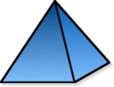
Pyramid Properties
Always , sometimes, never ?
It has an odd number of faces
No face is a quadrilateral
It has 12 edges
All faces are the same shape
It has an odd number of edges

Slide 18
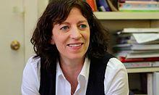
Jo Boaler – Visualisation Activity
Work out 18 x 5 and show a visual solution
Mathematical Mindsets

Slide 19
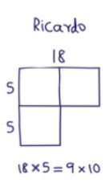
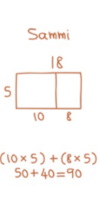

Slide 20
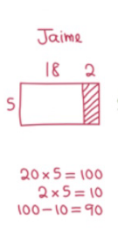
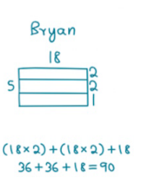
From Jo Boaler Mathematical Mindsets 2016

Slide 21
Border Problem

Slide 22
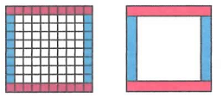
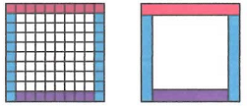
Solutions
10 + 8 + 10 + 8 = n + (n-2) + n + ( n-2)= 36
10 + 9 + 9 + 8 = n + 2(n-1) + n-2 = 36

Slide 23
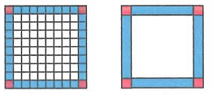
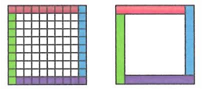
Solutions
4 x 8 + 4 = 4(n-2) + 4 = 36
9 + 9 + 9 + 9 = 4 x 9 = 4( n-1) = 36

Slide 24
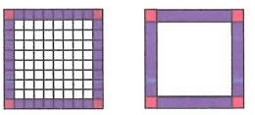
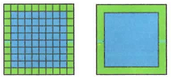
Solutions
(4 x 10) – 4 = 4 n – 4 = 36
(10 x10) – ( 8 x8)= n² - (n-2)²= 36

Slide 25
Looking for patterns
Write out the first few even numbers
2 4 6 8 10 12
Now let’s look at the sum of consecutive numbers
2
2+4=6
2+4+6=12
2+4+6+8=20
2+4+6+8+10=30
Anything remarkable about that?

Slide 26
Odd Numbers
Now let’s try it with consecutive odd numbers.
1 + 3 = 4
1 + 3 + 5 = 9
1 + 3 + 5 + 7 = 16
1 + 3 + 5 + 7 + 9 = 25
Does the pattern continue?

Slide 27
Odd Numbers
1 + 3 + 5 + 7 + 9

Slide 28
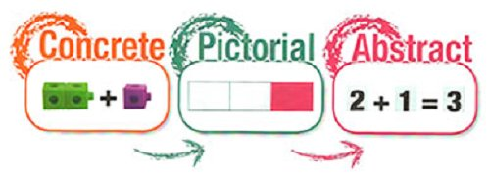
CPA Model Jerome Bruner
Iconic
Symbolic
Enactive
Notes:
However, that leaves out a stage of development, as Bruner’s (1966) three modes of representation show in this warranted perspective on early learning of number: Enactive. Often referred to as concrete, where muscle memories are continually reinforced through remembering the feel of actions. Therefore thinking is based entirely on physical actions. This mode continues later in many physical activities, such as learning to ride a bike. Iconic. Information is stored as sensory images, usually visual ones like pictures in the mind. This begins from 18 months of age. Some will develop an extreme form of this known as eidetic imagery (photographic memory), but they usually lose it as they grow older. Thinking is based on the use of mental images (icons), which are based on sight, but can also be hearing, smell or touch. Symbolic/Abstract. Refers to the ability to store things in the form of symbols. This mode is acquired around six to seven years old (corresponding to Piaget’s operation stage).
Representation of the world is principally through language, but also other symbolic systems such as number and music.

Slide 29
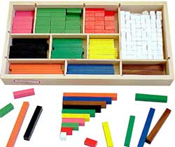
Concrete representation
The enactive stage
An idea or skill acted out with real objects.
This is a 'hands on' component using real objects
Foundation for conceptual understanding.
Eg Twelve divided by 2

Slide 30
Pictorial representation
The iconic stage
Relating hands on experience to representations, such as a diagram or picture of the problem.

Slide 31
Abstract representation
The symbolic stage
Representing problems using mathematical notation
For example: 12 ÷ 2 = 6 This is the ultimate mode, for it "is clearly the most mysterious of the three."

Slide 32
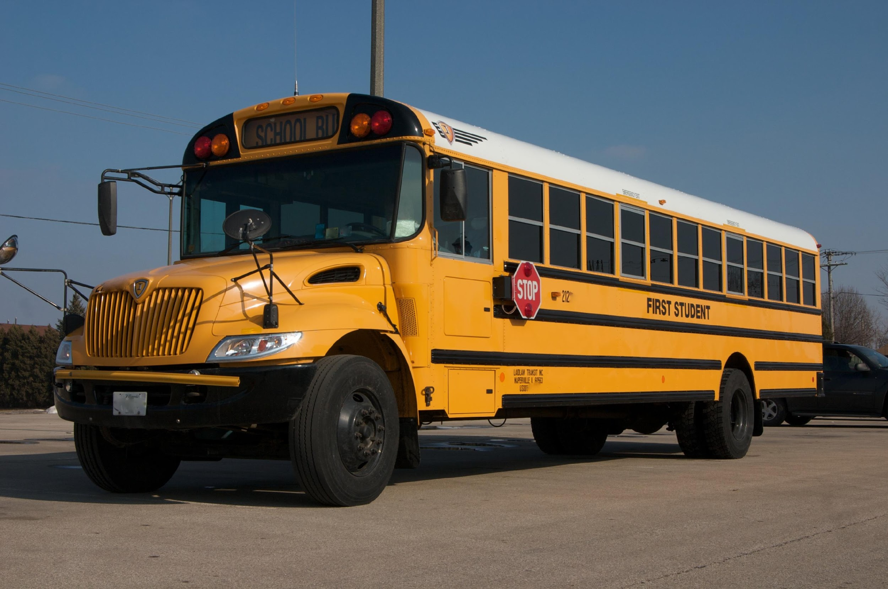

Slide 33
Finger Activities
Berteletti, I., & Booth, J. R. (2015).

Slide 34
Rocking the Piano

Slide 35
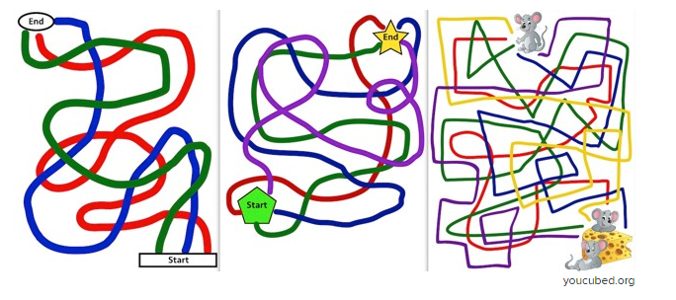
Finger Maze
Gracia-Bafalluy, M. and Noel, M. P. (2008)

Slide 36
Singapore Maths
Notes:
Tiny, 200 sq mi, densely populated island in Southeast Asia.
Originally, a fishing village that was colonized by the British in 1819 when it was seen as a potential trading post.
Occupied by Japan during WWII
Returned to Great Britain in 1945
Gained independence in 1965.
Most of the people who live in Singapore are of three different nationalities: Chinese, Malay, and Indian.
They live, work and attend school together.

Slide 37
Big Ideas in Singapore Maths
Visualisation
Concrete Pictorial Abstract
2. Number sense
3. Generalisation/Making connections and finding patterns
4. Communication
5. Metacognition
6. Systematic Variation

Slide 38
Bar Modelling

Slide 39
Bar Model example
Zack spent 1/5 of his savings on a gift and ½ of the remainder on a book.
The book cost $12.
How much were Zack’s savings?

Slide 40
Zack’s Savings
Zack spent 1/5 of his savings on a gift and ½ of the remainder on a book. The book cost $12. How much were Zack’s savings?
1/5 on the gift
1/5 on a gift |  |  | Book ($6) | = $12 ($6)

Slide 41
Further Examples
Aaron has three times as much money as Beth. Together, they have $156.
How much do they each have?

Slide 42
Divide by 3? Divide by 4?
Aaron
Beth
Aaron has three times as much money as Beth. Together, they have $156.
How much do they each have?

Slide 43
Mia Shopping problem
Mia saved up some money for shopping. Her mother gave her $150 more. At a shop, Mia spend $80 on a bag and half of the remaining money on a pair of shoes. She was then left with $55. How much money did she save up?
? | 150
80 | 55 | 55

Slide 44
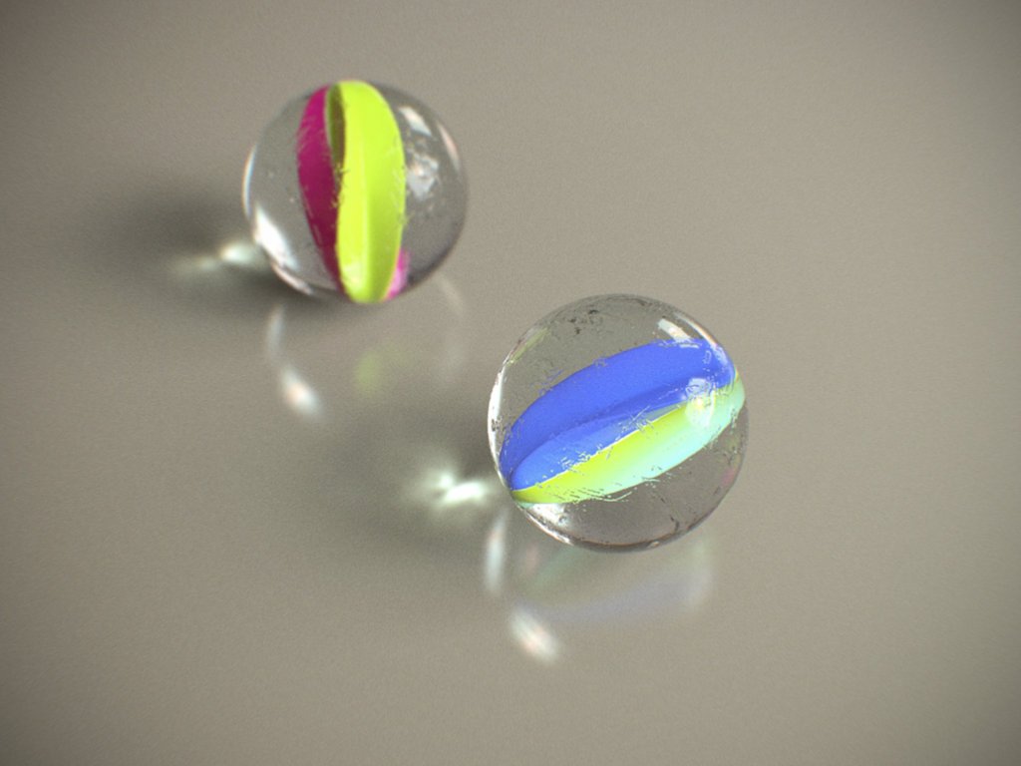
Before and After Problem
Sam had 5 times as many marbles as Tom. If Sam gives 26 marbles to Tom, the two friends will have exactly the same amount.
How many marbles do they have altogether?

Slide 45
Before
Sam
Tom
After
Sam
Tom
Where are the 26 marbles? Can you see?

Slide 46
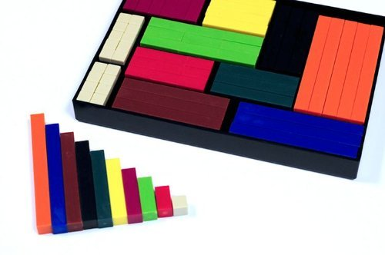
Professor Sharma Four major principles for teaching
Use of Appropriate Concrete Models
2. Levels of Knowing Mathematical Ideas
3. The Three Components of a Mathematical
Idea
4 The Questioning Technique Professor Sharma Berkshire Mathematics

Slide 47
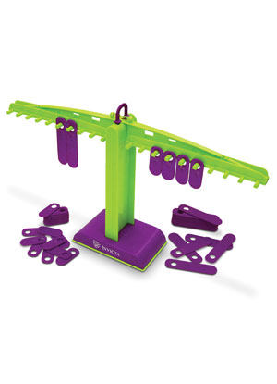
1.Use of Appropriate Concrete Models
For early mathematical concepts, it is important that a child experiences mathematics through appropriate and efficient learning models. Cuisenaire rods, base 10 materials and the Invicta Balance provide appropriate models for these concepts.

Slide 48
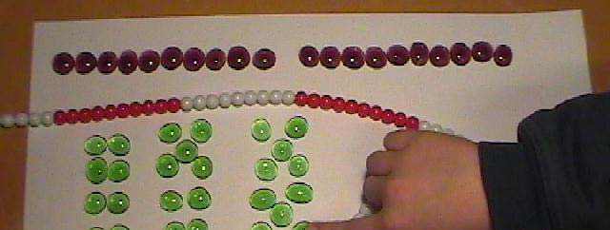
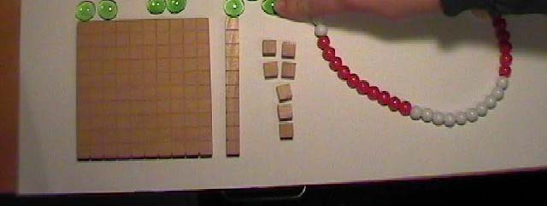
Concrete Materials

Slide 49
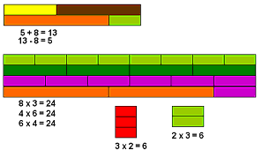
2. Levels of Knowing Mathematical Ideas
Intuitive
Concrete
Pictorial
Abstract
Applications
Communication
Notes:
.

Slide 50
3. The Three Components of a Mathematical Idea
Language
Procedure
Concept

Slide 51
4. The Questioning Technique
For the development of concepts, the teaching process must engage the child by asking key questions.
Appropriate questioning is important for the introduction of a concept, for reinforcing it and for helping the child to memorise facts.

Slide 52
References
Ramful and Lowrie (2015)
http://www.merga.net.au/documents/RP2015-56.pdf- University of Canberra
Berteletti, I., & Booth, J. R. (2015). Perceiving fngers in single-digit arithmetic problems. Frontiers in Psychology, 6, 226. doi:10.3389/fpsyg.2015.00226
Bruner, J. S. (1966). Toward a theory of instruction, Cambridge, Mass. Belkapp Press
Boaler, J (2016) Mathematical Mindsets: Unleashing Students’ Potential through Creative Math, Inspiring Messages and Innovative Teaching. Chappaqua, NY: Jossey-Bass/Wiley.
Gracia-Bafalluy, M. and Noel, M. P. (2008) Does finger training increase young children’s numerical performance? Cortex, 44(4), 368-375
Professor Mahesh Sharma www.mathematicsforall.org

Slide 53
Any Questions?
www.judyhornigold.co.uk
judy@judyhornigold.co.uk
#dyscalculiainfo

