Slide 1
SPELD
October 2016
Session 4
Curiosity, Collaboration and Creativity in Maths

Slide 2
Curiosity
Gelman and Ranganath (2014)
Research on how curiosity influences memory.
“link between the mechanisms supporting extrinsic reward motivation and intrinsic curiosity and highlight the importance of stimulating curiosity to create more effective learning experiences”

Slide 3
Maths
It is magic until you understand it and it is mathematics thereafter.
Bharati Krishna
Author of Vedic Mathematics

Slide 4
Vedic Maths
Adding Time
1hr 35 mins plus 3 hr 55 mins
135 + 355= 490
Now add 40
490 +40= 530
So 1 hr 35 mins plus 3 hr 55 mins is
5 hrs and 30 mins
Try it yourself!

Slide 5
Dividing by 9
23 / 9 = 2 remainder 5
The first figure of 23 is 2, and this is the answer. The remainder is just 2 and 3 added up
43 / 9 = 4 remainder 7
The first figure 4 is the answer and 4 + 3 = 7 is the remainder

Slide 6
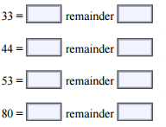
Try it yourself!

Slide 7
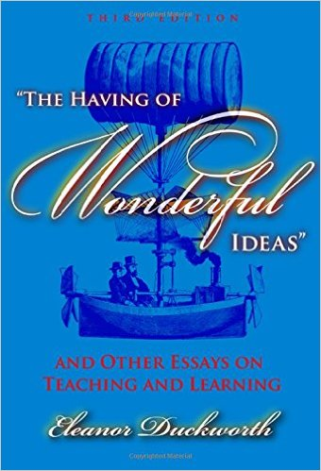
The Having of Wonderful Ideas

Slide 8
Maths is no more computation than typing is literature
John Allen Paulos
Professor of Maths in Philadelphia

Slide 9
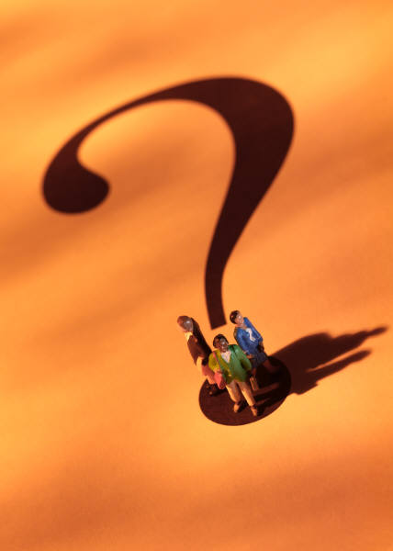
Question or Answer?
Is maths about getting the right answer or asking the right question?

Slide 10
In Mathematics the art of proposing a question must be held of higher value than solving it
Georg Cantor- German Mathematician- Inventor of Set Theory

Slide 11
What If…?

Slide 12

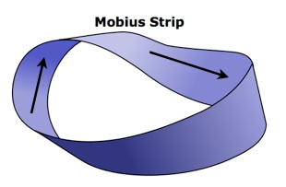
Curiosity
Magic Square
The Golden Ratio
Everlasting Chocolate
Mobius strip
Notes:
Discussion- can you come up with any other ideas that would involve curiosity-feedback at end

Slide 13
Coloured Squares
1)Up/ Down stop on any blue
2)Left/right stop on any yellow
3)Up/down stop on any red
4)Left/right stop on any green

Slide 15
Sagrada Familia
1 | 14 | 14 | 4
11 | 7 | 6 | 9
8 | 10 | 10 | 5
13 | 2 | 3 | 15

Slide 16
Sagrada Familia
Each Column, Row and Diagonal adds to 33
1 | 14 | 14 | 4
11 | 7 | 6 | 9
8 | 10 | 10 | 5
13 | 2 | 3 | 15

Slide 17
Also !
1 | 14 | 14 | 4
11 | 7 | 6 | 9
8 | 10 | 10 | 5
13 | 2 | 3 | 15

Slide 18
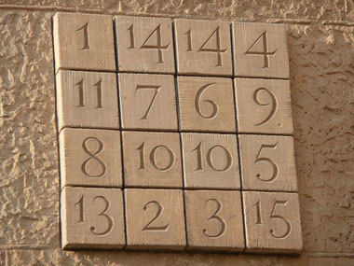
Why 33?
33 was the age that Jesus was crucified
There are dozens of combinations of numbers that would produce a similar square- with numbers adding to 33

Slide 19
Mathematics has beauty and romance. It’s not a boring place to be, the mathematical world. It’s an extraordinary place; it’s worth spending time there.
Marcus du Sautoy

Slide 20
What’s so special about 2016?
Can we use the numbers 1 to 10 and the four number operations to make 2016?
10x9x8x7x6
5+4+3+2+1
3³ + 4³ + 5³ + 6³ + 7³ + 8³ + 9³ = 2016

Slide 21
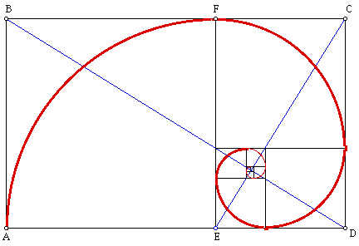
The Golden Ratio

Slide 22
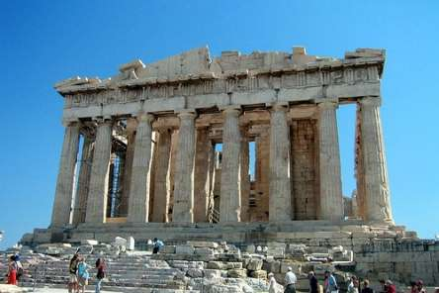
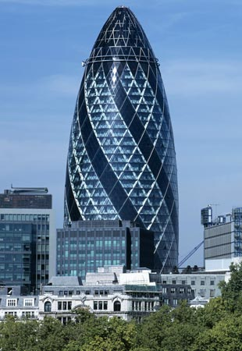

Slide 23
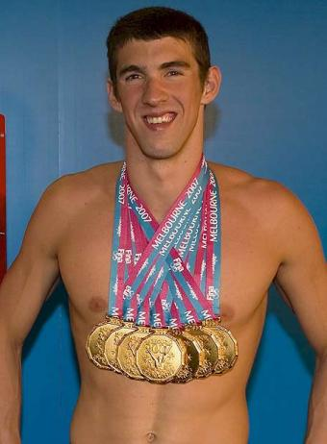
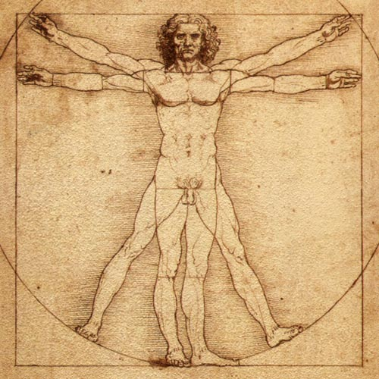

Slide 24
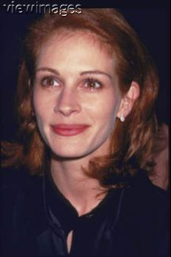
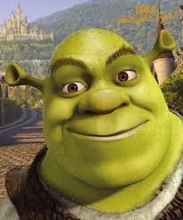
The Perfect face?

Slide 25
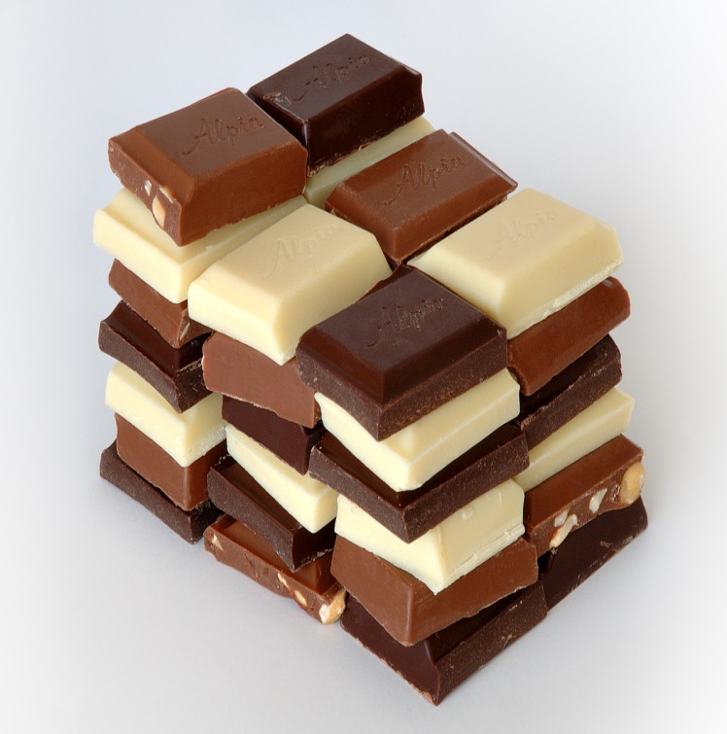
Everlasting Chocolate
https://www.youtube.com/watch?v=ltqHJTY8Fhk
Notes:
You tube

Slide 26
Mobius Strip

Slide 27
Curious Number
Notes:
Curious Number
Stage: 2
Can you order the digits 1,2,3,4,5 and 6 to make a number which is divisible by 6 ...
... so that when the final or last digit is removed it becomes a 5-figure number divisible by 5?
And when the final digit is removed again it becomes a 4-figure number divisible by 4?
And when the final digit is removed again it becomes a 3-figure number divisible by 3?
And when the final digit is removed again it becomes a 2-figure number divisible by 2, then finally a 1-figure number divisible by 1?

Slide 28
Two possible solutions
123654
321654

Slide 29
A solution for 0-9?
3816547290
3 is divisible by 1
38 is divisible by 2
381 is divisible by 3
3816 is divisible by 4
38165 is divisible by 5
381654 is divisible by 6
3816547 is divisible by 7
38165472 is divisible by 8
381654729 is divisible by 9
3816547290 is divisible by 10

Slide 30
Multiplying by 11
26 x 11= ?
286
61 x 11=?
671

Slide 31
How does it work?
26 x 11
Add 2 and 6 which equals 8 and put that between the 2 and the 6
26 x 11 = 286
48 x 11= 4 ( 4 +8) 8
In the case we would have 4128, so we need to add the 1 to the first digit , giving 528

Slide 32
Teaching Tricks
Write down any three-digit number
Multiply it by 13
Multiply that answer by 7
And, finally, multiply that answer by 11
What do you notice?
Does it always work?
Why?

Slide 33
Collaboration
As the African proverb goes:
"If you want to go fast, go alone. If you want to go far, go together.”

Slide 34
Collaboration
Four fours
Beans and Bowls/Partitions
Nomography
Magic V
Notes:
Discussion- can you come up with any other ideas that would involve collaboration-feedback at end
Beans and bowls= 10 beans and 3 bowls
Bbxbbbxbbbbb
Partitions= ciusenaire rods- to break numbers up into positive numebrs
3 can be broken in four different ways
Is 1 and 2 the same as 2 and 1
Coming up for a general pattern for how many partitions there is is an unsolved maths problem= welcome to cutting edge maths

Slide 35
Four Fours
1= 4/4 x 4/4
16 = 4 + 4 + 4 + 4

Slide 36
Beans and Bowls
How many ways are there to arrange 10 beans among 3 bowls?
Partitions= simplify to 3 beans
1 + 1 + 1
2 + 1 + 0
2 + 0 + 0
What about 0 + 2 + 0? Is that different?

Slide 37
Partitions
Solution for 10?
One of the greatest unsolved problems in maths is to find a general pattern for how many partitions a number has.
Welcome to the cutting edge of Maths!

Slide 38
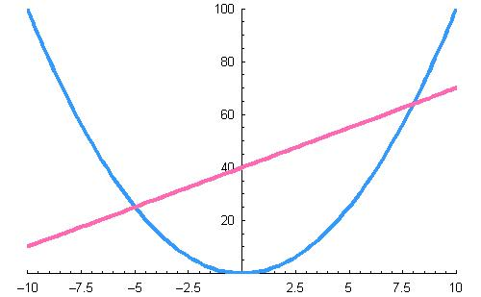
Nomography
Notes:
I read lots of Math books and I've run into many many interesting Math "things" in my travels but here's something very clever I've never encountered before. Let's say you want to multiply 5 by 8. Do the following:
Plot the graph of y=x^2.
Draw a line that crosses the parabola where x = -5 and where x = 8 on the parabola. (Ignore the fact that x = -5 and not +5 at the left intersection point; this calculator does not do signed arithmetic!)
Note the value of y where the line crosses the y-axis.
The value of y is 40 and indeed 5 x 8 = 40.
Can you figure out why this trick works? Never mind that it's much more work to plot the graphs and determine where the line crosses the y-axis than it is to do the arithmetic in the first place!
This clever exploration, plus a number of other nice explorations for high school students come from the book Mathematics: A Human Endeavor by Harold Jacobs.

Slide 39
Magic V
Place the numbers 1 to 5 in the circles so that each arm of the V adds to the same total

Slide 40
Magic V
Can you predict the situation if the numbers were 2,3,4,5,6?
What if the numbers were 103, 104, 105, 106, 107?
Can you repeat this for 1-7 with a V that has 4 circles in each arm?

Slide 41

Creativity
Tessellations
Odd one out
Chocolate Chilli Roulette

Slide 42
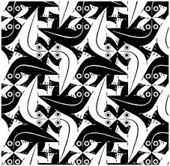
Escher Tesselations
http://www.youtube.com/watch?v=T6L6bE_bTMo
Notes:
Note from the webmaster: It may make more sense to you if you label the outside corners PART. In step 3, rearrange the PARTs with the letters at the CENTER, so they spell TRAP.
Here are some other word combinations that work: PETS/STEP, POTS/STOP, EVIL/LIVE or FLOG/GOLF, BRAG/GARB or TRAM/MART, TIME/EMIT, PANS/SNAP, or RATS/STAR.
Nrich building stars http://nrich.maths.org/1268

Slide 43
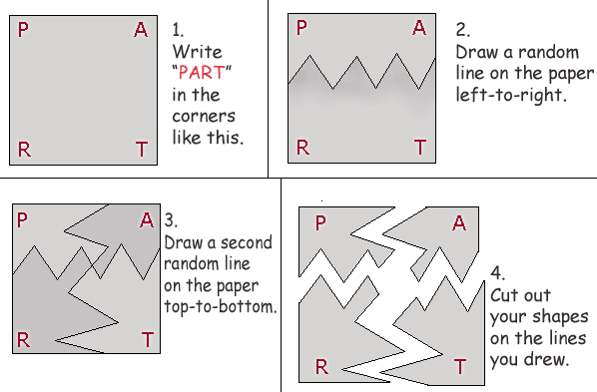
Tesselations

Slide 44
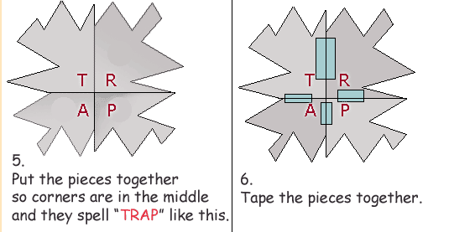
Tesselations

Slide 45
Odd one out
23 20 15 25
Which number is the odd one out?
Notes:
Thinking creatively can engage learners in mathematical reasoning with the different reasons given acting as springboards for further inquiry:
Can you find some other numbers with exactly three factors?
How many numbers under 100 have digits that add to 7?
Creativity as a key to deeper learning?
One popular argument for encouraging creativity is that we live in times of rapid change and being creative helps learners cope with such changes. Over and above this the work of the psychologist Ellen Langer suggests that creativity can have other payoffs.
Langer has extensively researched what she calls the conditionality of knowledge: that what we hold to be ‘true’ relies on certain conditions (in this case 20 is the odd one out under the conditions of odd and even numbers).
Langer’s research on Mindful Learning shows that treating knowledge as ‘conditional’ rather than ‘absolute’ not only leads to creativity but also to deeper learning of the knowledge being explored. In other words, justifying a range of answers may help kids become mathematically smarter.
I discuss these ideas more fully in my new book ‘Transforming Primary Mathematics’
Most people’s immediate response to ‘Odd one out’ is that 20 is ‘odd’ because it is ‘even’ (pun intended!). A moment’s reflection can open up a seemingly closed problem like this to some creative thinking.
Can we find a reason for each of these numbers being singled out as the odd one?
And how many different reasons for each number?
Here are some starters for 25. It is the only number in the set that:
is a perfect square number
is a factor of 125
has an odd number of factors
has digits that add to seven
….

Slide 46
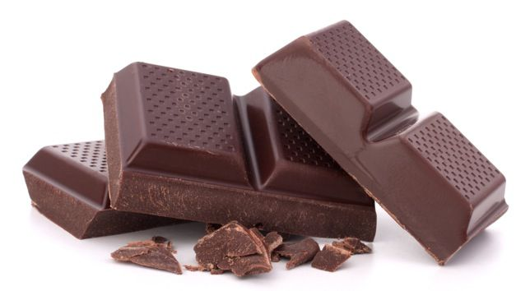
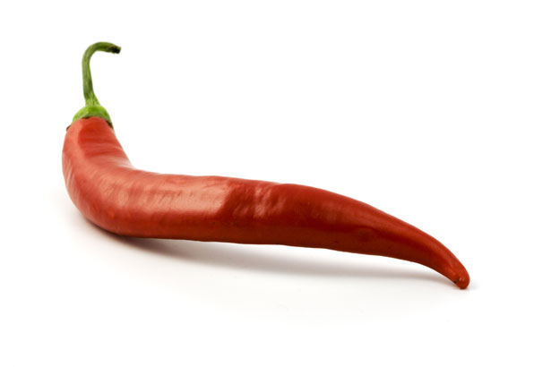
Chocolate /Chilli roulette
Notes:
13 bars of chocolate
1 chilli
Each player ( two players) can take one two or three items
Aim to force your opponent to take the chilli
As long as you get to go first there is a strategy to make sure that you win
You always need to take the amount that will make your go and your opponents add up to four
Exlpore for different amounts- different numbers to start with and different numbers that you can take

Slide 47
Chocolate / Chilli Roulette
13 bars of chocolate
1 chilli
Each player ( two players) can take one, two or three items
Aim to force your opponent to take the chilli

Slide 48
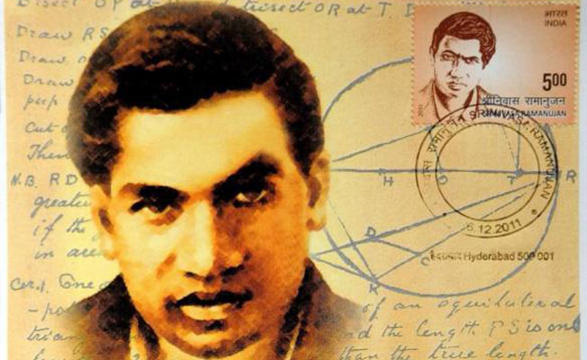
Ramanujan

Slide 49
Taxi Cab Numbers
Ramanujan number
1729 = 10³ + 9³
But also = 12³ + 1³
It is the smallest number with this property
It is a taxi cab (2) number because there are 2 ways of expressing it
Notes:
is taxicab (2) number because it has two ways of adding cubes
87539319 is a taxicab (3) number because there are 3 ways of adding two cube numbers and it is the number on this cab in futurama
87, 539, 319= 167³ + 436³ = 228³ +423³ =255³ + 414³

Slide 50
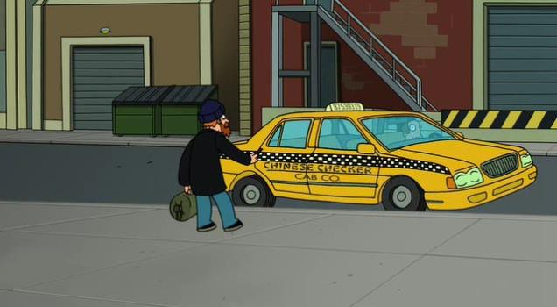
Taxi Cab Number
Notes:
Ramanujan number
1729=10³ + 9³
But also = 12³ + 1³
It is the smallest number with this property
is taxicab (2) number because it has two ways of adding cubes
87539319 is a taxicab (3) number because there are 3 ways of adding two cube numbers and it is the number on this cab in futurama
87, 539, 319= 167³ + 436³ = 228³ +423³ =255³ + 414³

Slide 51
Futurama Taxi Cab Number
87539319 is a taxicab (3) number because there are 3 ways of adding two cube numbers and it is the number on this cab in Futurama
87, 539, 319 = 167³ + 436³
= 228³ +423³
=255³ + 414³

Slide 52
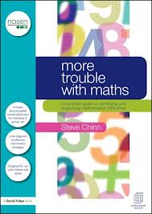
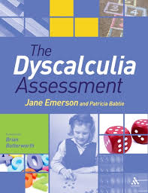
Resources

Slide 53
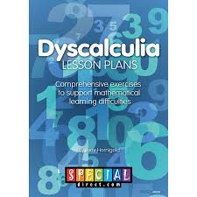
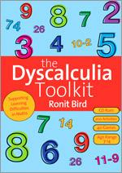

Slide 54
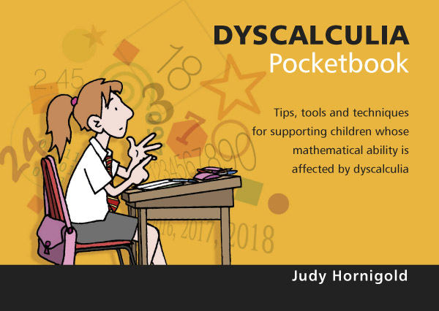

Slide 55
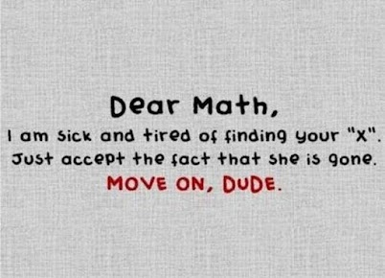

Slide 56
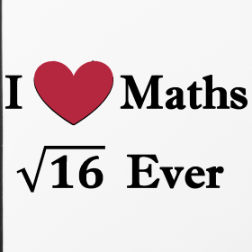

Slide 57
Any Questions?
www.judyhornigold.co.uk
judy@judyhornigold.co.uk
#dyscalculiainfo

Slide 58
References
Gruber, M. J., Gelman, B. d., & Ranganath, C. (2014) States of curiosity modulate hippocampus-dependent learning via the dopaminergic circuit. Neuron, 84(2), 486-496
Duckworth, E. The having of wonderful ideas.
www.nrich.org

