Slide 1
SPELD
October 2016
Maths Anxiety and Working Memory

Slide 2
Session Overview
Maths Anxiety
How to overcome maths anxiety
Techniques
Growth Mindset
Number sense
Number talks
Working Memory
How to improve memory function

Slide 3
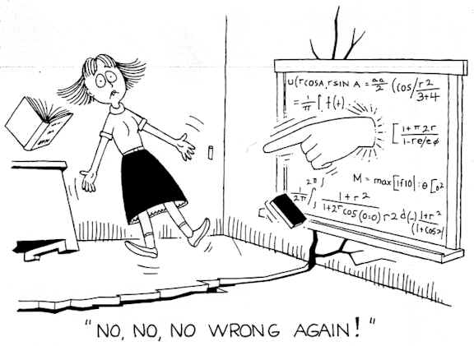
Math Anxiety

Slide 4
Activity
Turn to the person next to you and recall :
-a positive experience of maths at school
-a negative experience of maths
Notes:
Give my own experience
Talk about 70 year old wanting to do maths

Slide 5
Maths Anxiety- 4 phases
Phase 1 - Negative feelings towards maths
Phase 2 - Avoidance of maths
Phase 3 - Poor maths preparations
Phase 4 - Poor maths performance
Preis & Biggs (2001)
Mathematics anxiety affects mathematical performance by inhibiting working memory (Butterworth, Cipolotti & Warrington, 1996; Ashcraft & Kirk, 2001)
Feeling of tension, apprehension or fear that interferes with maths performance (Richardson & Shuinn, 1972)

Slide 6
Maths Anxiety- Definition
Maths anxiety has been defined as
‘the panic, helplessness, paralysis, and mental disorganization that arises among some people when they are required to solve a mathematical problem.’
Tobias and Weissbrod (1980)
Notes:
Brain not wired for abstract maths

Slide 7

A learned response
Anxiety rises when faced with mathematics and can be so severe that
even the sight of a maths problem can lead to paralysing anxiety
Fight or flight reaction
Notes:
Explain- adrenalin, pavlovian response

Slide 8
Identification
Professor David Sheffield- University of Derby UK
Maths Anxiety Scale – for adolescents and adults*
Numeracy Apprehension Scale- Children aged 4-7
* Free from Tom Hunt or David Sheffield at University of Derby

Slide 9
3 areas of focus
The fear of being evaluated whilst you do some maths- fear of being watched doing maths
Doing everyday maths- splitting a bill in a restaurant
Watching someone else do maths.

Slide 10

Physical Symptoms of Maths Anxiety
queasy stomach, butterflies
clammy hands and feet
increased or irregular heartbeat
muscle tension, clenched fists
feeling faint, shortness of breath
headache
shakiness
dry mouth
cold sweat, excessive perspiration

Slide 11
Psychological Symptoms of Maths Anxiety
negative self-talk
panic or fear
worry and apprehension
desire to flee the situation or avoid it altogether
a feeling of helplessness or inability to cope

Slide 12
Maths Anxiety can be related to
Life Experiences
attitudes of parents, teachers or other people in the learning environment
some specific incident in a student’s maths history which was frightening or embarrassing
poor self-concept caused by past history of failure
Notes:
Learner’s attitudes
Lack of belief in ability
Lack of faith in intuition
Negative beliefs
Giving up before really trying
‘Dropped stitch’ thinking
Depression
Fear of failure

Slide 13
Maths Anxiety can be related to
Teaching Techniques
Anxiety can be caused by teaching techniques which emphasize:
timed activities
the right answer
speed in getting the answer
competition among students
working in isolation
memorization rather than understanding

Slide 14

Maths lessons
“Evidence suggests that math anxiety results more from the way the subject is presented than from the subject itself.”
J. Greenwood (1984)
Notes:
Few maths classes are structured in such a way as to relieve anxiety. There will always be time limits, right answers, and competition. Reducing maths anxiety will not make students ‘smarter’ in maths. However, it could allow a students to reach their full potential

Slide 15
Activity
Do you have maths anxiety?
What situations make you anxious?
Does your teaching minimise anxiety for your learners?
Notes:
Give example of course – are you sure question

Slide 16
How to over come maths anxiety
Techniques
Foster the idea that mistakes are good
Don’t emphasise speed in Maths
Spend time developing number sense at an early age
Encourage a relaxed participatory atmosphere
( Number Talks)
Use concrete manipulatives in a way that develops understanding
( Singapore Maths)
Notes:
We will spend the rest of the talk looking at each of these in turn

Slide 17
Techniques to overcome Maths anxiety
David Sheffield , University of Derby
Short targeted intervention- 20 minutes for 5 days
Writing down your worries- based on Emotion Regulation Theory (Klein and Boals 2001)
Reappraisal of anxiety- Beltzer, Nock, Peter and Jamieson (2014)
Deep breathing/Slow breathing
Imagining Safe place
Humour

Slide 18
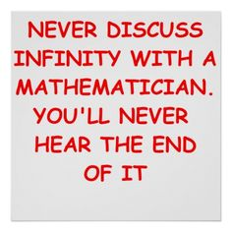
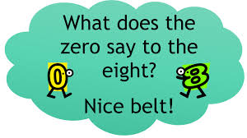

Slide 19
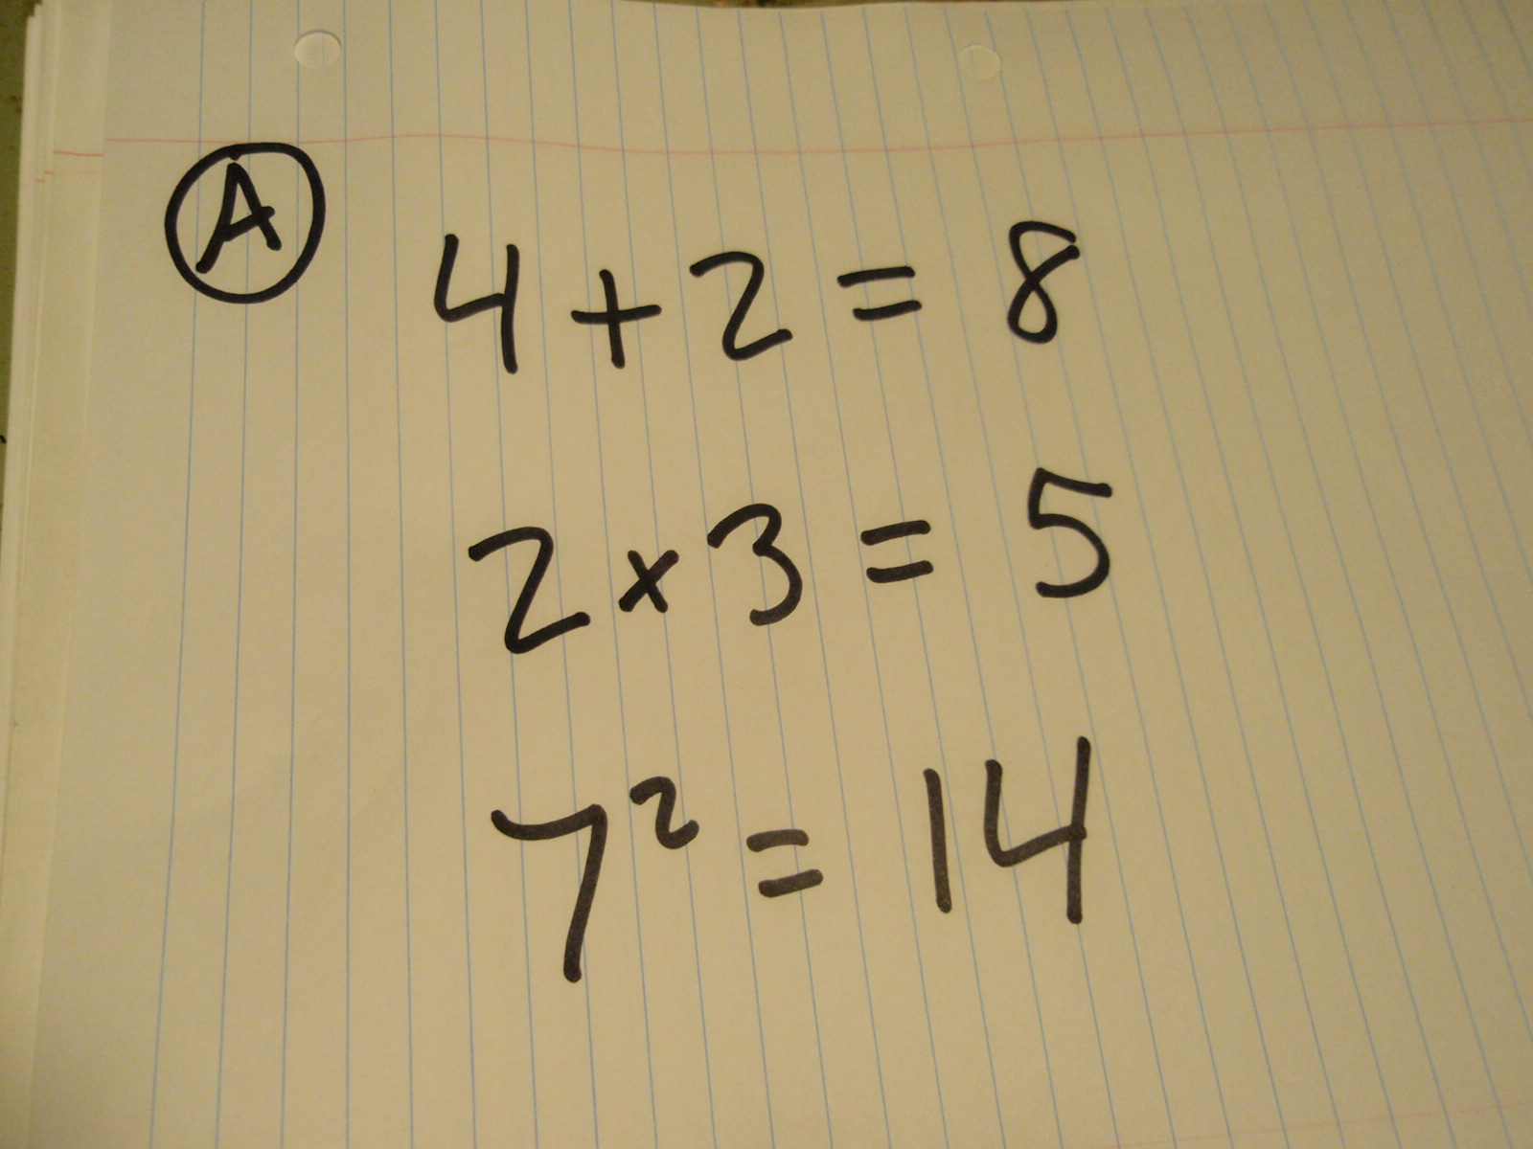
Mistakes are good
Notes:
Go through each of these mistakes
Talk about using mistakes to help understand the level that C are at and how they are thinking

Slide 20
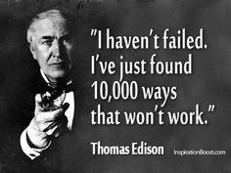

Slide 21

Mistakes
‘Every time a student makes a mistake in maths they grow a new synapse’
Carol Dweck
Notes:
No mistake – no growth

Slide 22
Mistakes matter
Mistakes are vital in maths
New data has shown that the brain grows when a mistake is made
No growth when the answer is correct
Notes:
If the answer is correct then there is no growth- the child does not even have to know why they got it wrong and they don’t have to go back and get it right- it is the struggle that counts
Most children feel really bad if they make a mistake , but they should feel that they are learning and that it will help them
This knowledge could go a long way to helping overcome maths anxiety

Slide 23
Mistakes are good
Move from a performance culture to one where tasks are open and promote growth
Give challenging work
Value persistence
Notes:
Children to need to think that they are there to enjoy, learn and grow
For children with maths anxiety
Screw up some paper into a ball and throw it at the board to represent how they feel when they cant do maths- then retrieve their paper and unscrew it- flatten it out and look at all the creases- these are the new synpases that have grown in the brain when the mistake was made or when you were struggling
We want children to feel comfortable making mistakes
Mistakes are when children learn the most
Students need challenging complex work
Environment where mistakes and persistence are valued

Slide 24

Activity

Slide 25
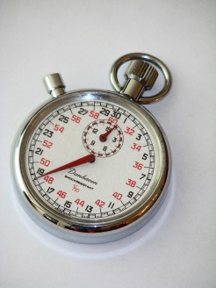
Does it matter how quickly we can answer?
Research evidence shows that maths should never be associated with speed
Timed tests cause the early onset of maths anxiety for about 1/3 of the children in the class
Being fast at maths is not the same as being good at maths
Most mathematicians think slowly and deeply
Notes:
We have a mile wide and inch deep curriculum- it should be narrower and much deeper
( reference the ks2 mental maths)
Professors of maths often don’t know their times tables- Jo Bolaer doesn’t

Slide 26
Lauren Schwartz- Fields Medal
‘ I was always deeply uncertain about my own intellectual capacity; I thought I was unintelligent. And it is true that I was, and still am, rather slow. I need time to seize things because I always need to understand them fully. Towards the end of the eleventh grade, I secretly thought of myself as stupid. I worried about this for a long time.
I’m still just as slow . . . . At the end of the eleventh grade, I took the measure of the situation, and came to the conclusion that rapidity doesn’t have a precise relation to intelligence. What is important is to deeply understand things and their relations to each other. This is where intelligence lies. The fact of being quick or slow isn’t really relevant.’
A Mathematician Grappling with His Century (2001)

Slide 27

Mindset
How important are the ideas that students hold about their own ability?

Slide 28
Carol Dweck: Mindset
Fixed mindset: Maths ability is a gift
Growth mindset: Maths ability grows with experience , persistence, learn from mistakes, determination to keep going, encouraged by other’s success
Mindset: The New Psychology of Success (2007)
Notes:
Carol Dweck has trained premier league footballers
If your mum says ‘I wasn’t any good at maths then the child’s marks will go down’
Fixed mindset comes from fixed praise
If a parent says you are clever, then the child will hear that , but this can backfire later if they struggle with something because they think that this means they are not clever
Better to say you have tried really hard. You have done really well
Experiment- half of a class were given one extra sentence in their feedback from teachers and the other half did not have that sentence.
The chidlren with the extra sentence did better when tested one year later
The sentence was I am giving you this feedback because I believe in you

Slide 29
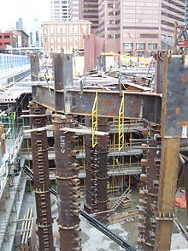
Carol Dweck
We can all be ‘fly highers’
We are not all ‘high fliers’
The higher you want to build
the deeper the foundations
need to be

Slide 30
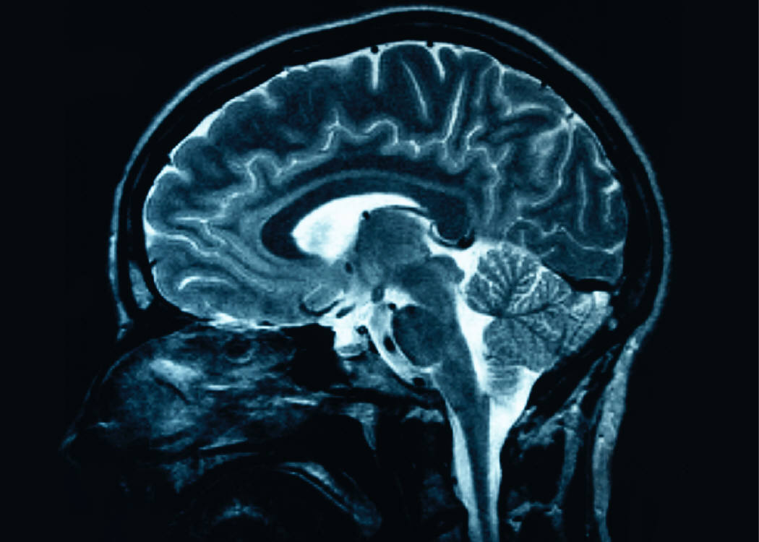
Plasticity of the brain

Slide 31
Examples
London taxi drivers
6 year old epileptic
3 week training programme- 10 minutes a day
Notes:
Synapses are like footprints in the sand- the brain follows the footprints and makes them deeper the more they are followed- if not rehearsed it will wash away
The plasticity of the human brain means that the connections grow into adulthood- and all the way through adulthood
London cabs- 25,000 streets and landmarks- enlarged hippocampus- shrinks back once retired
6 year old girl
So a second example of brain growth was a
nine year old girl who had half of her brain move, removed.
She was having fits and they literally took out one hemisphere.
And at first her left side, her whole left side was paralyzed, but she amazed
doctors. As within weeks she'd grown connections
back and eventually in a very short time developed all of her functions back.
And that was because of the incredible and fast growth of her brain.
Epilepsy
Half brain removed
Within months she had recovered functions from the missing side of her brain. It grew back!
3 week training programme
Changed the structure of participant’s brain-10 mins a day for three weeks

Slide 32
Implications
Each child has enormous potential to grow their brain, no matter where their starting point is
Teachers have the power to take children to high levels
Brain difference at birth has minimal impact on future learning- it is nurture rather than nature that matters.

Slide 33
Mindset and Maths
Lowest achieving children are those who use a memorization technique for maths
Highest achievers are those who look for connections and have big ideas
Notes:
Lowest achieving are actually doing the hardest maths

Slide 34
Which Mindset do you model?
Promotes a Fixed Mind Set | Promotes a Growth Mind-Set
Praising students for being smart | Praising effort and strategies
Formative comments that emphasis achievement | Formative comments that emphasise effort and application
Praising students for achievements that come easily | Building robust self confidence
Spending time documenting intelligence and ability | Spending time developing intelligence and ability
Directing students to which tasks to complete | Giving students a strong voice in the learning process and a sense of purpose
Boosting self esteem | Providing constructive criticism
Place importance on grades / levels rather than learning | Place importance on learning rather than grades / levels

Slide 35
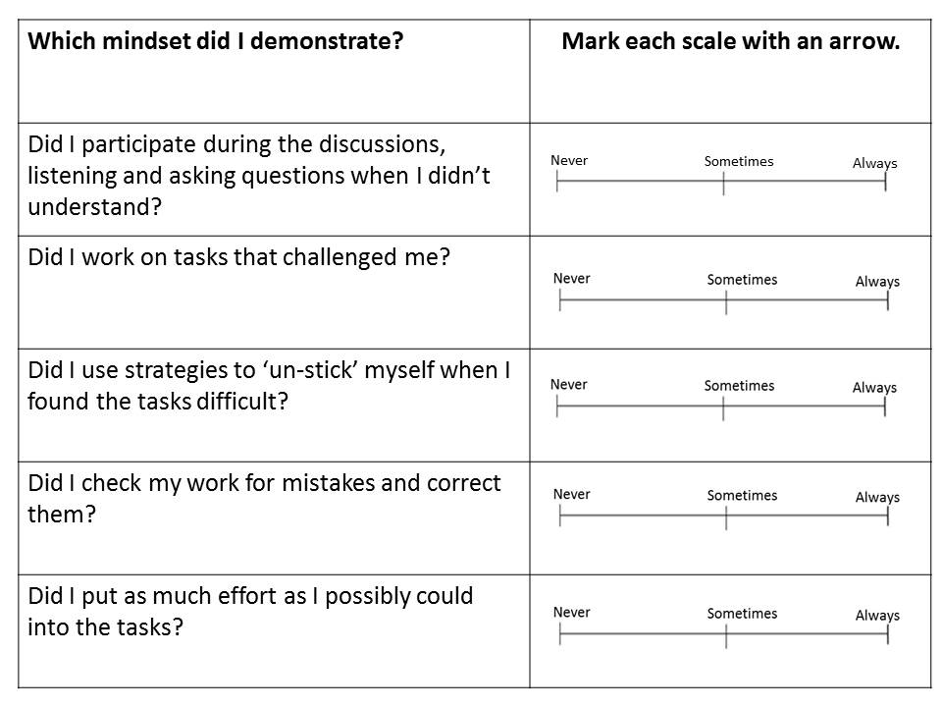

Slide 36
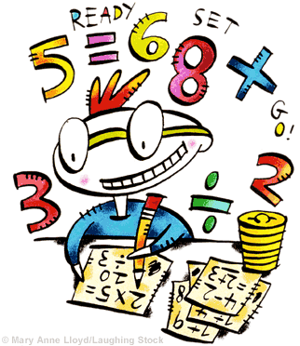
Number Sense?

Slide 37
What is Number Sense?
“Number sense is an emerging construct that refers to a child’s fluidity and flexibility with numbers, the sense of what numbers mean and an ability to perform mental mathematics and to look at the world and make comparisons.”
  Russell Gersten, David Chard

Slide 38
What is Number Sense?
Example:
  6 is half of 12
  It’s also 3 doubled
  1/3 of 18
  2 sets of 3
  3 sets of 2
  1 more than 5
  1 less than 7

Slide 39
Pattern spot over rule remember
2000 x 0.25 19+ 64+ 31+ 6
2000
-187
____
1999
-186
____

Slide 40
With and without context?
2003-1996
2003
-1996
_____

Slide 41
Can you do this?
(7 x 34) + (66 x 7)
7 x 100 = 700
Reasoning means that I don’t need to bother with calculations

Slide 42
Always, sometimes, never true?
Squares are rectangles?
Rectangles are squares?
All isosceles triangles are equilateral?
All equilateral triangles are isosceles?

Slide 43
Coincidence or connection?
5 x 4 = 20
10 x 2 = 20

Slide 44
A Checklist of a Numerically Powerful Child
Develops meaning for numbers and operations
Looks for relationships among numbers and operations.
Understands computation strategies and uses them appropriately and efficiently.
Makes sense of numerical and quantitative situations.
Notes:
Connects numerals with situations from life experiences.
Knows that numbers have multiple interpretations.
Understands that number size is relative.
Connects addition, subtractions, multiplication, and division with actions arising in real-word situations.
Understands the effects of operating on numbers.
Creates appropriate representations for operations.
Decompose or breaks apart numbers in different ways.
Knows how numbers are related to other numbers.
Understands how the operations are connected to each other.
Multiplication/Division-Inverse
Addition/Subtraction-Inverse
Multiplication-Repeated Addition
Division-Repeated Subtraction
Expects numerical calculations to make sense.
Seeks to understand relationships among quantities in real-world situation.
Assesses whether the result of a calculation makes sense in the context of the numbers and real-world quantities involved.

Slide 45
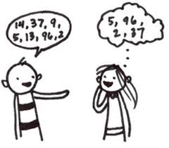
Number talks
http://www.youtube.com/watch?v=la3_trsAnMs
Notes:
http://www.youtube.com/watch?v=la3_trsAnMs

Slide 46
What are Number Talks?
Number Talks are a valuable classroom routine for:
• making sense of mathematics
•developing efficient computation strategies
•communicating reasoning and proving solutions

Slide 47
What are Number Talks?
5-15 minute classroom discussions
Ongoing
Most effective if done every day

Slide 48
Number Talk format
Teacher presents a problem
Students figure out possible solutions
Students share their possible solutions
Students share their thinking
The class agrees on the answer for the problem
Notes:
Defend their ideas- share

Slide 49
Example
76+ 25
A problem in which students can decompose numbers to solve
1 ÷ 2/3
A much harder problem!

Slide 50

Working Memory

Slide 51
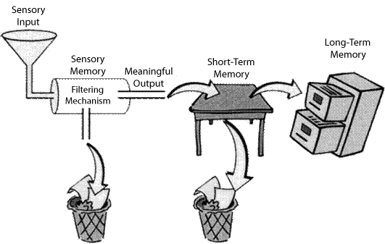

Slide 52
Short-term Memory
Short-term Memory is part of the Working Memory system. It comprises:
Visuo-spatial memory
Verbal memory
Used for storing material without manipulating it mentally, or doing something else at the same time,
e.g. remembering a telephone number uses verbal short-term memory.
e.g. picking out a top to match the skirt you just bought uses visuo-spatial memory
Notes:
Temporary storage space
Eg for telephone number you have just looked up
When no longer needed it is discarded
Information in short term memory is fragile and is easily lost through distraction or after about 30 seconds
We can select information from short term memory to store in long term memory

Slide 53
Long Term Memory
Permanent Storehouse
A system for permanently storing, managing, and retrieving information for later and ongoing use. Items of information stored as long-term memory may be available for a lifetime.
Information which has been registered, encoded, rehearsed, and stored for future retrieval; Material and information retained in LTM underlies cognitive abilities.

Slide 54
Working Memory
Welcome to the 2-minute, 4-unit jotting pad!
‘A mental workspace to BOTH hold AND manipulate information in the mind.’
e.g. 43 x 67 (without pen, paper or calculators).

Slide 55
Working Memory
IN
Encoding*
OUT
Retrieval
The Central Executive
Manipulating

Slide 56
Why is Working Memory Important?
Students who struggle to learn academically will almost certainly have working memory difficulties
Problems are best defined in terms of:
Capacity
Time

Slide 57
Sub Systems of WM
1. Phonological Loop
2. Visual-Spatial Sketchpad
3. Central Executive

Slide 58
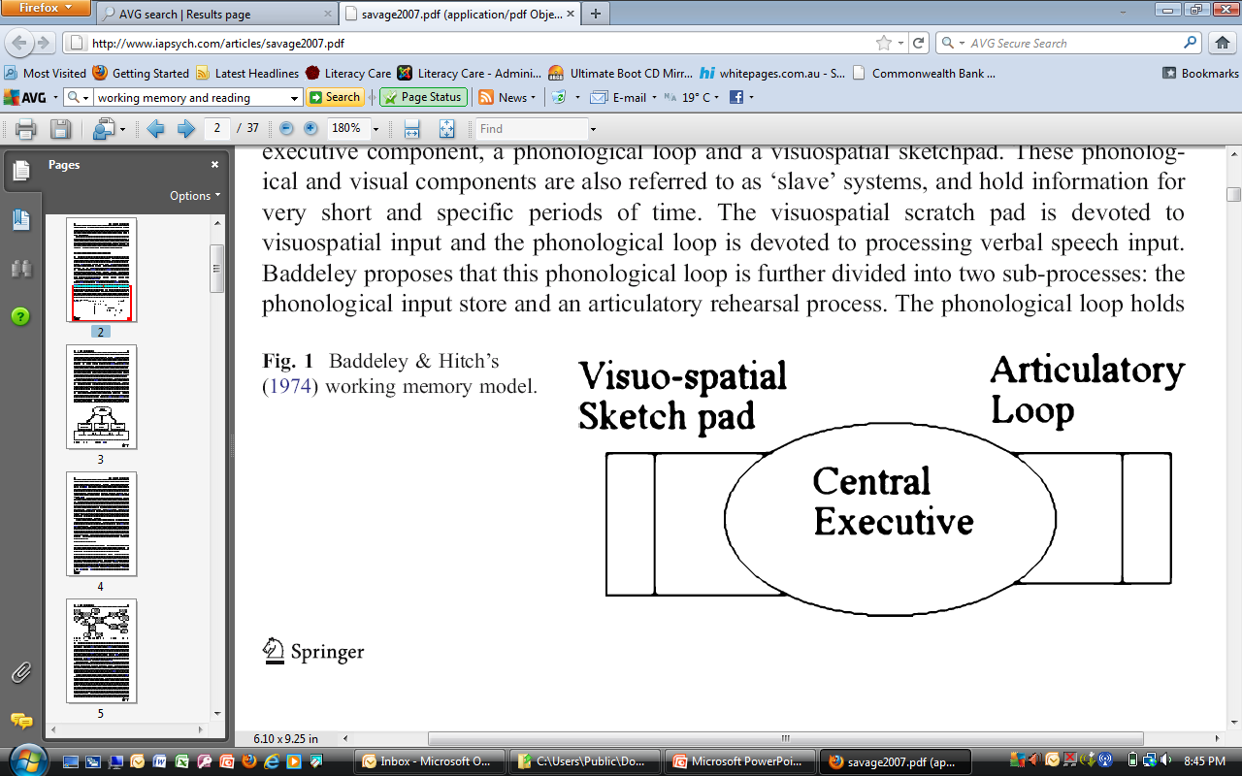

Slide 59


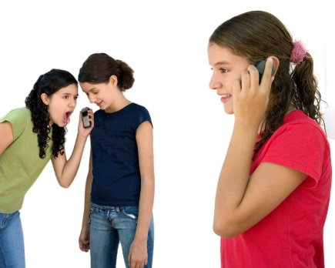

Distractions to Working Memory
Time’s up!

Slide 60
How to improve memory function
3 Ms
How can I make it manageable?
How can I make it multisensory?
What memory aids can be used?

Slide 61
Manageable
Make it manageable- reduce the load on working memory
Avoid dual processing
Look for patterns in and/or chunk series
Work for short periods
Read what you need to read
Plan written work
Use technology

Slide 62
Chunking information reduces memory load
Give yourself 10 seconds to rehearse this number sequence. Then click to clear the screen - jot down what you can remember
36552124313028

Slide 63
Now Try these?
Y E O S D
R V C I
T E I N C
N D F O
E R I F N O B
T H G I N

Slide 64

Multi-sensory
Make it multi-sensory- increase the power of encoding by using a variety of stimuli
Use videos and CD Roms
Lists, wall charts
Talk and discuss
Role play
Colour code
Be active

Slide 65

Memory
Make use of memory aids- to facilitate recall
Notes – sound note app
Record
Review/summing up
Visual imagery
Transfer from left to right side

Slide 66
How to make things more memorable
For information to stay in the memory it must be clearly and firmly registered
Registration needs to be:
Clear and unambiguous
Rehearsed and reinforced
Understood and connected to existing information
Actively attended to
Notes:
Introductions at a party or at beginning of this course
How many names did you remember?

Slide 67
What do we remember most in any period of learning
Information at the beginning and at the end
Information associated with other information
Extraordinary things
Repeated information
Information that links to us personally

Slide 68
What we remember least
Information presented in the middle
Anything that is not outstanding in any way
Anything that is not associated or linked

Slide 69
Implications
Learning periods should be short- 10 to 20 minutes
Breaks- used to put new learning in the context of old learning- links made
Extraordinary- unusual- engaging and motivating

Slide 70
Other ways to help
Make learning experiences simultaneously multisensory
Make learning meaningful by:
  using discovery as a strategy
  teaching a structured programme that links new learning to past learning

Slide 71
Explicitly address memory difficulties:
teach how to discard irrelevant information
foster the ability to categorise
foster the ability to make connections to aid memory
practise tracking tasks that encourage target words and symbols to be held in memory during the search

Slide 72
References
Tobias, S., & Weissbrod, C. (1980). Anxiety and mathematics: an update. Harvard Educational Review, 50(1), 63-70.
Greenwood, J. (1984). Soundoff: my anxieties about math anxiety. The Mathematics Teacher, 77, 662-63.
Baddeley, A. D., & Hitch, G. (1974). Working memory. In G.H. Bower (Ed.), The psychology of learning and motivation: Advances in research and theory (Vol. 8, pp. 47–89). New York: Academic Press.
Dweck, C. Mindset: The New Psychology of Success (2007), Ballantine Books
Boaler, J . www.youtubed.com
Hunt, T.E., Clark-Carter, D. & Sheffield,D, 2011

Slide 73

Any Questions?

