Slide 1
SPELD
October 2016
Maths Learning Difficulties: Dyscalculia, Dyslexia or Dyspraxia?

Slide 2
Session Overview
Demands of Maths
Dyscalculia, Dyslexia, Dysgraphia- definitions and identification
Impact of each difficulty on maths learning
Strategies to help:
Key facts and derived facts
Learning Styles
Use of concrete materials

Slide 3
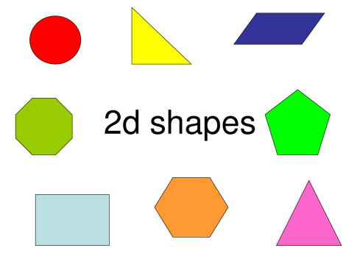
Demands of Maths
Success in Maths requires
visual and verbal abilities
spatial skills for understanding shape, symmetry, relative size and quantity,
linear skills for understanding the sequential and ordered symbols and representations found in the number system and algebra
(Joffe 1980).

Slide 4
Furthermore
Sequencing
Accuracy
Understanding of arbitrary symbols
Effective storage, access and retrieval
Effective and flexible working memory
The ability to combine creativity with rigorous mental organisation
The ability to learn and apply rules
The ability to process text swiftly and effectively
The ability to draw simultaneously upon a range of learning styles and preferences.
These are not qualities typical of the SpLD learner, however committed and intelligent that learner may be

Slide 5
Language of maths
Succinct
Ambiguous
10 biscuits on a plate I eat all but three of them . How many are left?
Words with multiple meanings
'difference', ‘table', 'odd', 'mean‘, 'product’ and ‘degree’

Slide 6
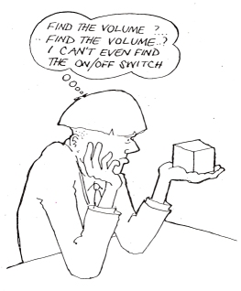

Slide 7
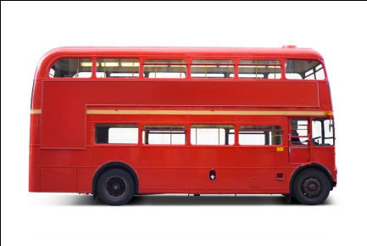
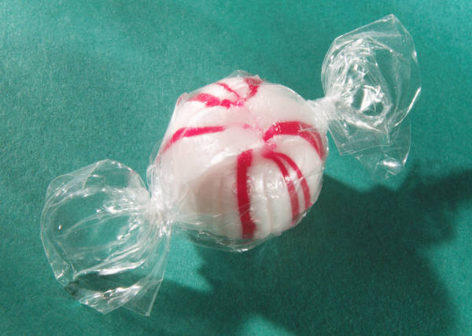
Translating Maths
Dix hommes se sur un bus puis quatre descendu. Combien en reste dans le bus?
I have eight sweets in my pocket. I eat two and give half of the rest to my sister. How many are left in my pocket.
Notes:
Look at the first sentence- we can have a good go at extracting meaning from this even if we have very little knowledge of French. However, to translate the second sentence into French would be much harder as we do not have the detailed knowledge and understanding of the French language.
It is the same in Maths- to develop a deep understanding of mathemaical language we need to be able to translate from the abstract maths to maths language

Slide 8
Activity
Make up a word problem for 9-4=5
Now:
If the answer is 24 then what could the question be?
Notes:
These sorts of activities give the child the opportunity to develop mathematical language and thereby deepen their understanding.
The second activity focuses on the idea that maths can be thought in terms of questions rather than answers and is inclusive because children of all abilities can have a go and come up with their own ideas.

Slide 9
Notes:
This example of the importance of mathematical language was shown to me by Patricia Babtie ( co author of the dyscalculia assessment with Jane Emerson). The child had been asked to copy the patterns of orange triangles and you can see that his first attempt was quite inaccurate.
The second attempt at the bottom of the page was achieved only 30 mins later. The difference being that the intervening 30mins had been spent talking about the patterns and using mathematical language to identify the features of the triangles and their relationship to each other.
A really powerful example of the importance of mathematical language

Slide 10
Subtypes of Developmental Dyscalculia
Dyscalculia can affect different aspects of maths ability- leading to a variety of maths profiles. Karagiannakis and Cooreman (2014) have identified four areas or subtypes. Dyscalculic learners may have difficulty in all or maybe just one or two to these areas:
Core Number
Reasoning
Memory
Visual Spatial

Slide 11
Core Sub types
Dyscalculia
Core Number
Reasoning
Dyslexia
Memory
Dyspraxia
Visual Spatial

Slide 12


Definitions
Dyscalculia
Dyslexia
Dyspraxia

Slide 13
Dyscalculia
DSM-IV (2000)
Mathematics Disorder:
"as measured by a standardised test that is given individually, the person's mathematical ability is substantially less than would be expected from the person’s age, intelligence and education. This deficiency materially impedes academic achievement or daily living"

Slide 14
Dyslexia
Rose Review (2009)
Report on Identifying and Teaching Children and Young People with Dyslexia and literacy Difficulties
‘Dyslexia is a learning difficulty that primarily affects the skills involved in accurate and fluent word reading and spelling.
‘Characteristic features of dyslexia are difficulties in phonological awareness, verbal memory and verbal processing speed.
‘Dyslexia occurs across a range of intellectual abilities. It is best thought of as a continuum, not a distinct category, and there are no clear cut-off points.

Slide 15
Rose Definition cont’d
‘Co-occurring difficulties may be seen in aspects of language, motor co-ordination, mental calculation, concentration and personal organisation, but these are not, by themselves, markers of dyslexia.
‘A good indication of the severity and persistence of dyslexic difficulties can be gained by examining how the individual responds or has responded to well founded intervention.’

Slide 16
Dyspraxia
Dyspraxia literally means ‘ difficulty in carrying out an action’
Medically speaking it denotes difficulty planning and executing movement.
It causes difficulty with spatial and perceptual skills
Subtype of Developmental Co-ordination Disorder

Slide 17
Dyspraxia
DSM – V definition
The acquisition and execution of coordinated motor skills is substantially below that expected given to the individual’s chronological age and opportunity for skill learning and use and that this significantly and persistently interferes with activities of daily living.
The motor skill difficulties are not better explained by visual impairment, neurological disorder or another medical condition.

Slide 18

Identification : Dyscalculia

Slide 19
Indicators of Dyscalculia
An inability to subitise even very small quantities
Poor number sense
An inability to estimate whether a numerical answer is reasonable
Immature strategies- for example counting all instead of counting on
Inability to notice patterns
Inability to generalise
Notes:
Subitising comes from Latin= ‘Sudden’
It is the ability to give the amount of objects in a set without counting
Most people can subitise up to five or six objects
Dyscalculic people do not have this ability- they may not even be able to subitise a set of two items
Is this innate? Are we born with the ability to assess quantity?
Yes, being able to identify quantity is a survival instinct and is innate in us all- but people with dyscalculia may not have this ability
Number sense
The ability to determine the number of objects in a small collection, to count, and to perform simple addition and subtraction, without direct instruction.
Spoken language and number sense are survival skills but abstract maths is not.
Go through each of these indicators and discuss with the group;
Do they recognise these difficulties in any of their learners?
Why and how would these difficulties impact on their ability to learn maths
Main ones to highlight are- inability to subitise, persisitance in using immature strategies, inability to notice patterns, and inability to estimate.

Slide 20
Indicators of Dyscalculia (cont’d)
Slow processing speed
Difficulty sequencing
Difficulty with language
Poor memory for facts and procedures
Difficulties in word problems and multi step calculations

Slide 25
How do you identify and assess for dyscalculia?
Numeracy Screener- Daniel Ansari
Dynamo Profiler
Dyscalculia Screener- Butterworth
DyscalculiUM- FE/HE screener
Questionnaire/Checklist
Observation

Slide 26

Numeracy Screener

Slide 27
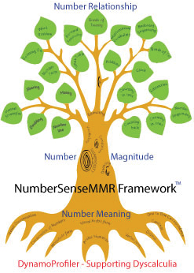
Dynamo Profiler

Slide 28
Notes:
Examples of reports that are available from the website
This students does not have dyscalculia.
You can get from the manual which is available online at www.mathematicalbrain.com
Normed for 6-14 years
Claims that it depends little on educational experience of child or other cognitive skills
Teacher report available for single student or group
Parent report
Cut-off score – bottom 10%
If dyscalculia is on a spectrum of difficulties rather like dyslexia, it could give false negatives
Pupils tested who demonstrate all the traits on checklist still come out as negative
Gifford (2005) feels results may reflect lack of early number experience
Pupils get bored, press any key

Slide 29

Dyscalculium
A screener designed at Loughborough University for post 16 students

Slide 30
Questionnaire/ Checklist
BDA www.bdadyslexia.org.uk
Ann Arbor www.annarbor.co.uk

Slide 31
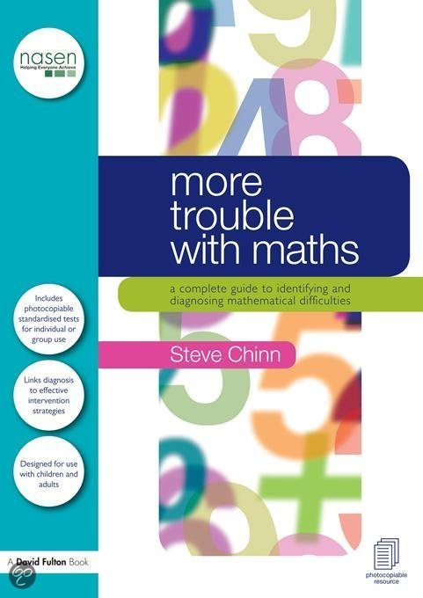
More trouble with Maths: Steve Chinn
Dyscalculia Checklist
Observation sheet
Short term and working memory test
60 second test for addition and subtraction
120 second test for multiplication and division
Maths anxiety assessment
15minute maths test
Test of cognitive style TCSM
Word problems

Slide 32
Observation
In class
Observe how they attempt a question
Look for signs of stress
Encourage the learner to verbalise how they are attempting the maths
Notes:
One of the most informative ways to assess for dyscalculia is to observe the learner in a maths class, ask them to verbalise to you how they are doing the maths and what strategies they are using

Slide 33
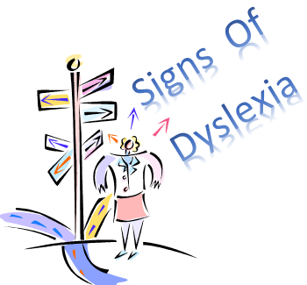
Identification: Dyslexia
Phonological Deficit
Memory
Processing Speed

Slide 34
Identification
Checklists
Screening
Diagnostic assessments

Slide 35
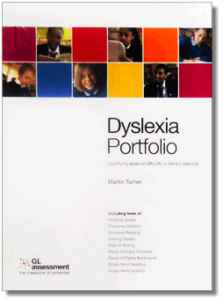
Screening
GL Assessment
Dyslexia Assessment
Dyslexia Portfolio
Pearson
Dyslexia Screening Test

Slide 36
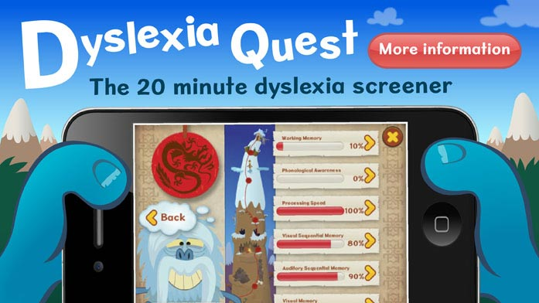
Nessy- Dyslexia Quest
https://www.youtube.com/watch?v=5kZR12SelpY

Slide 37
Nessy -Dyslexia Quest
6 games that each screen a different ability
Covers ages: 8-10, 11-16, 17+
Accuracy proven by evidence-based trials
Explains dyslexia warning signs
Cost is around $20 AUS
www.nessy.com

Slide 38
Identification Dyspraxia
A pupil with dyspraxia may :
Appear clumsy or awkward in their movements- often bumping into objects, tripping over, spilling things
Have difficulty with fine and gross motor activities, such as writing, ball skills
Have good verbal skills and high IQ but have poor motor performance
Struggle with daily activities, such as tying shoe laces, brushing teeth
Appear uninterested in physical activities

Slide 39
Other difficulties
Have low self esteem
Have poor organisation skills
Find it difficult to follow a teacher’s verbal instructions.
Significant difficulty finishing work on time
Or may rush through the task producing messy, haphazard work.
Poor visuo- spatial awareness

Slide 40
Who can diagnose?
GP needs to refer to one or more of the following
Paediatrician
Child and Adolescent Psychiatrist
Occupational Therapist
Physiotherapist
Speech and Language Therapist
Psychologist

Slide 41
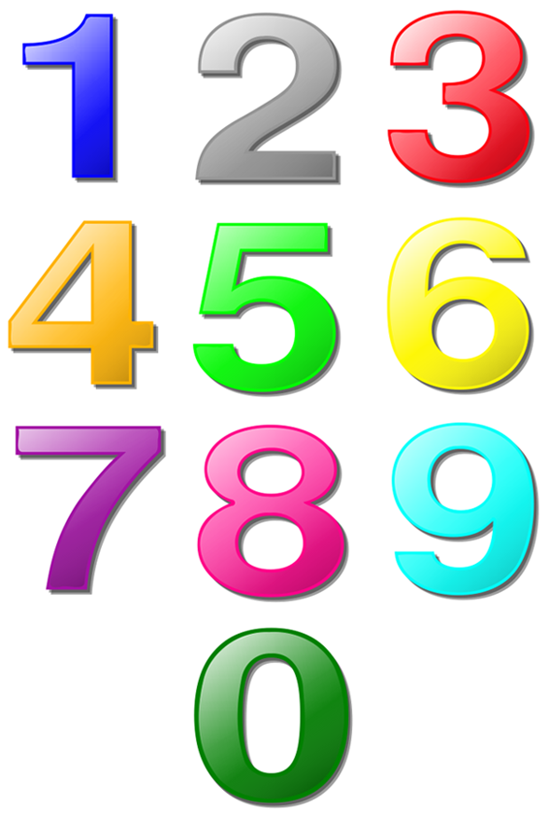
Impact on maths learning- Dyscalculia
Core number
Number sense
Estimating
Assessing difference in numerical quantity
Understanding maths symbols
Place value
Placing numbers on a number line

Slide 42
Ways to help
Activities that focus on the connections between numbers as quantities and symbols
Practise rounding numbers/Estimation
Use base ten materials- to support understanding of number
Use ten frames and five frames
Encourage verbalisation
Explore how numbers relate to each other to develop number sense

Slide 43
3

Slide 44
Practice rounding numbers
Use a viewer
Place over number to be rounded
Digit to be rounded
Digit to be checked

Slide 45
One decimal place
1 2 . 3 6 5 7
Is this digit 5 or more ?
YES
Round up
1 2 . 4

Slide 46
One decimal place
2 5 . 9 2 4
Is this digit 5 or more ?
NO
2 5 . 9
Leave unchanged

Slide 47
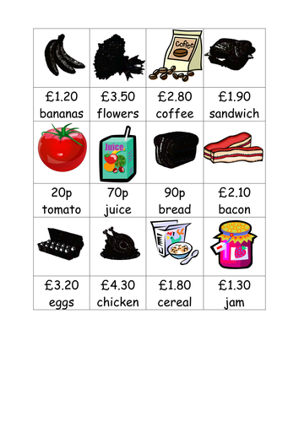
Estimation
1) Throw a handful of counters on the table
Estimate and then group into tens
2)Select cards with pictures of items and prices
Can we buy the items with $10?

Slide 48
Five frames

Slide 49

Impact on maths learning- Dyscalculia
Reasoning
Understanding relationships and mathematical concepts
Generalising and transferring information
Understanding multiple steps in complex algorithms
Problem solving and decision making
Recognising patterns

Slide 50
Ways to help
Explicitly demonstrate the link between maths and everyday situations
Role play mathematical scenarios
Represent maths concepts with diagrams and manipulatives
( Singapore Bar Model)
Develop metacognitive skills

Slide 51

Making maths real
6 + 8
What could we have 6 of?
Why would we need to add 8?

Slide 52

Use ten frames

Slide 53
Methods
Method 1- bring 4 from the 8 to make ten from the 6 frame
Method 2- make both frames 7- then we have double 7=14
Method 3- take 2 from the 6 to make the 8 into 10
Method 4- 20 subtract the 6 spaces?
Method 5 – skip counting in 2’s
Can we skip count in 5’s?

Slide 54
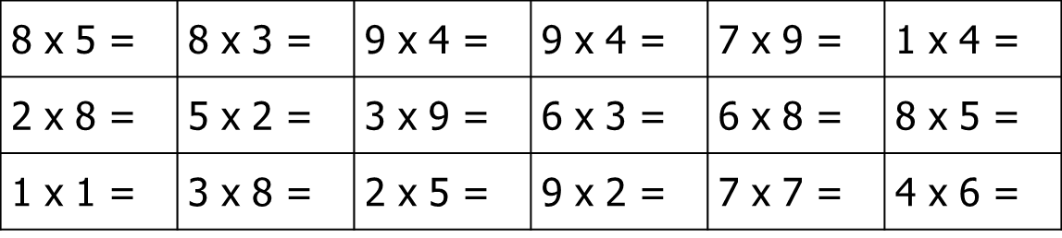
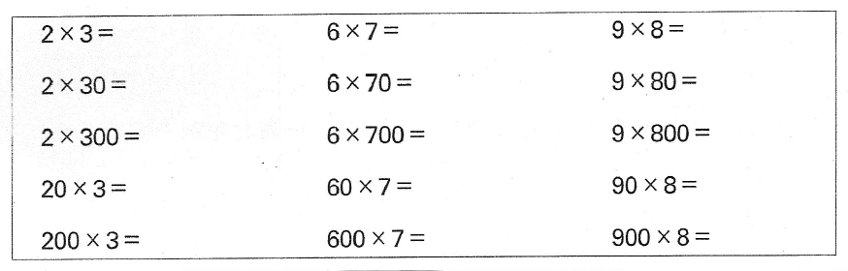
Generalising

Slide 55
Impact on maths learning- Dyslexia
Memory
Short Term Memory
Working Memory
Long Term Memory
Speed of working
Reading
Sequencing

Slide 56
Ways to help
Short term memory
( 3 items or less)
Working memory
Chunking
Repetition
Table squares
Addition squares
Give questions based on what they do know ( 2x , 5 x and 10 x)
Allow notes for mental arithmetic

Slide 57
Ways to help
Long term memory
Teach key facts and derived facts
Teach how to draw up a multiplication square or an addition square
Provide memory cards/booklets

Slide 58
Ways to help
Speed of working
Reading
Give more time- come back to the pupil later
Give x table square
Verbalise and draw word problems
Repeat and chunk
Coloured overlay
Personal dictionary
Reword the question

Slide 59
Ways to help
Sequencing
Explicitly point out patterns
Close procedure for sequences
Model with Cuisenaire rods
Support memory of procedures with understanding
Explore patterns on 100 square

Slide 60
Impact on maths- Dyspraxia
Visual/Spatial
Recognising and understanding symbols x and +
Direction
Recording /writing up
Organisation
Visualising geometric figures such as 3D shapes
Transposals
Interpreting graphs and tables

Slide 61
Ways to help
Symbols x and +
Being overfaced on a page
Direction
Clear font and size
Look out for perseverating- ( continuing to add when symbol has changed)
Verbalise
Use aperture cards to highlight individual questions
Colour
Highlight
Arrows

Slide 62
Ways to help
Recording/writing up
Organisation
Visualising Figures such as 3D shapes
Scaffold/ Model
Frames/templates
Close procedure worksheets
Squared paper/ vertical lines
Encourage use of colour
Isometric paper
Verbalise what you can see visually to support weakness in spatial awareness

Slide 63
Ways to help
Transposals
Interpreting graphs and tables
Play card search games with
pairs of transposed numbers eg 61 and 16 cards
Just for teens numbers?
Estimate answer first
Use L shaped rulers for tables
Use rulers with handles and non slip rulers
Coloured highlighters for key words

Slide 64
Other Strategies
Key facts and Derived facts
Learning Styles
Concrete materials

Slide 65

Key facts and Derived facts
Consider our money system
10c 20c 50c $1 and $2
Why have we chosen these amounts?

Slide 66

Key Facts
Key Facts are the ‘easy know’ facts
The same for every times table
2xn=
5xn=
10xn=

Slide 67
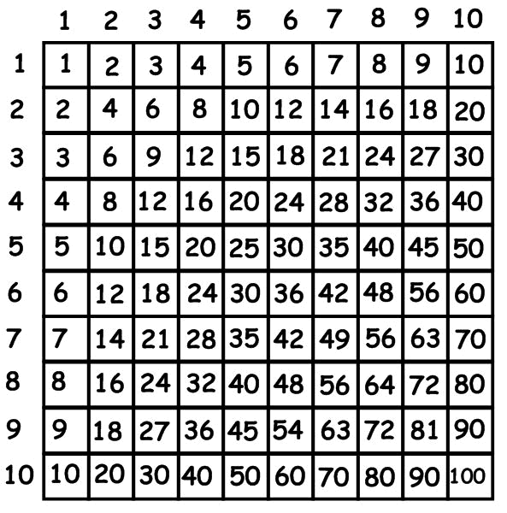
Using key facts for times tables

Slide 68
Key facts
Multiplication by repeated addition
The ‘Key Facts’ are: 1x 2x 5x 10x
3 x 8 =8 + 8 + 8 1 x8 and 2x8
6 x 8 =8 + 8 + 8 + 8 + 8 + 8 1x8 and 5x8
7 x 8 =8 + 8 + 8 + 8 + 8 + 8 + 8 2x8 and 5x8
12 x 8 =8+8+8+8+8+8+8+8+8+8+8+8
2x8 and 10x8
Notes:
Cuisennaire rods can be used here to model the multiplication arrays- and then you can go through the stages in turn
Number strips and number squares are also useful

Slide 69
Derived facts
If we know that 5+5=10 then what else can we derive from this?
50+50=100
5+6=11
5+4=9
Gray, E. M., & Tall D. O. (1991).

Slide 70
Derived Facts
72 students aged 7 – 13 years… addition
Above average:
9% counted on
• 30% known facts
• 61% derived facts
Below average:
72% counted on
• 22% counted all
• 6% known facts
• 0% derived facts
Gray and Tall. 1994. University of Warwick
Notes:
http://www.youtube.com/watch?v=Jeel4Qjow4s

Slide 71
Making Links

Slide 72
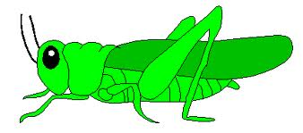
Learning Styles
Meet the inch worm and the grass hopper

Slide 73
Maths Learning Styles
Inchworm
Grasshopper
Uses numbers exactly as given
Prefers pencil and paper
Often checks using the same method
Prefers addition
Works in serial, ordered steps forward
Adjusts, breaks down, builds, plays with numbers
Tends to calculate mentally
Verifies using a different method
Finds it easier to work back from whole

Slide 74
Preferred apparatus
Inchworm
Grasshopper
Number lines
Multilink; unifix
Counting blocks
Attribute blocks
Graph paper & grids
Geoboards
Dienes blocks
Cuisenaire rods
Chinn and Ashcroft, 1999

Slide 75
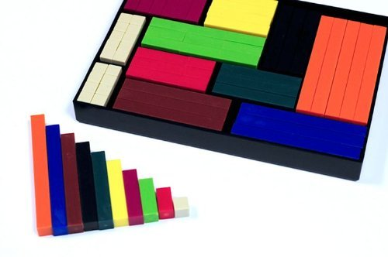
Concrete Manipulatives

Slide 76
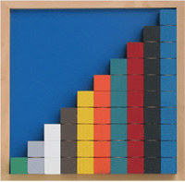
What are concrete manipulatives?
Real materials that can be moved touched and felt
Discrete Materials- objects such as counters, coins, plastic animals, glass nuggets, cubes
Continuous materials-Cuisenaire rods, Stern blocks,
Base Ten equipment
Abstract Models: Empty or partially empty number lines
Notes:
Base Ten created by Dienes
1000s, 100s flats,10s longs, units.
Some researchers point out that some learners do not perceive the manipulative in the way it is intended
• Learners may think the 1000 cube represents 600 because they can
see 6 faces of 100 ones per face.
• In fact, ten flat yellows are represented in one thousand cube

Slide 77
Concrete materials
Numicon
Ten frames
Base ten
Cuisenaire rods
Place value counters
Interactive manipulatives

Slide 78
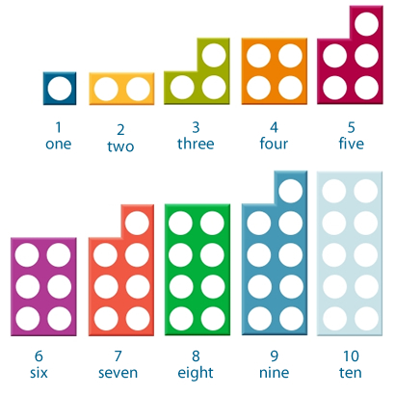
Numicon
Notes:
Commercially great to manipulate great odd and even
Stick to one pattern to begin with
Looking for a strong visual image of the pattern.
What could be limitations of this- or problems with this
( eg strong rep could mean inability to generalise- how would you over come this?)

Slide 79



Use of the ten frames
3
6
9

Slide 80
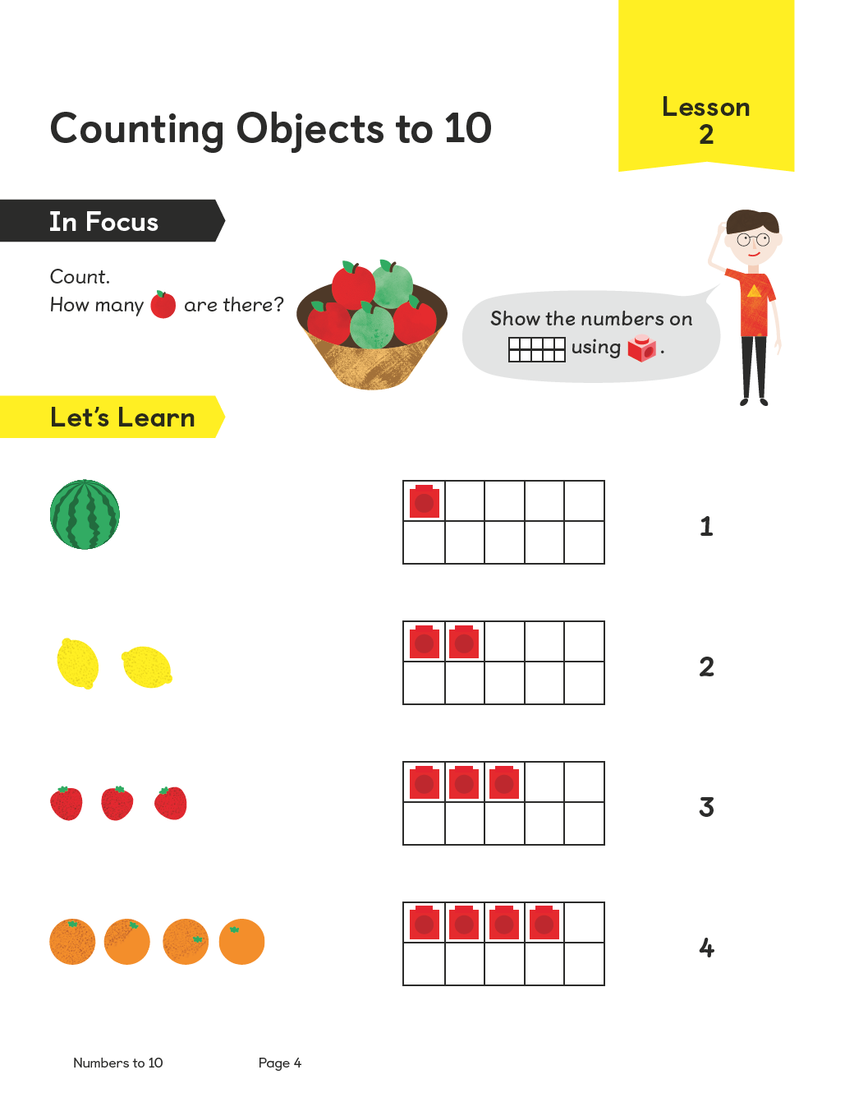

Use of the ten frames
1
The 10 frame appears early in year 1.
2
Initially it is used as a pictorial model to represent numbers
up to 10

Slide 81
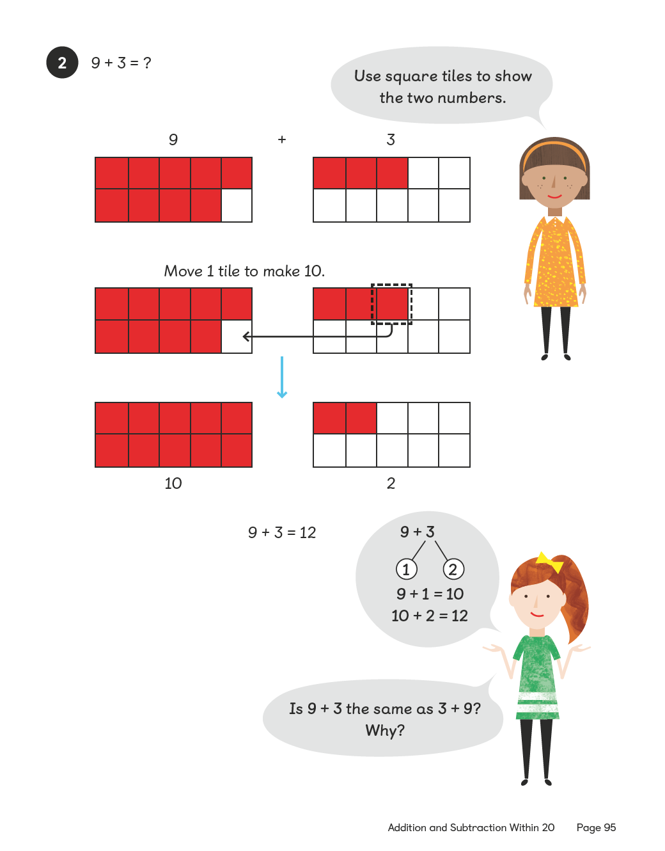
Use of the ten frames
1
It is used for adding numbers up to 20
2
Alongside the number-bond diagram it helps build a mental model to develop a strong number sense which is later used as a platform for making decisions.

Slide 82
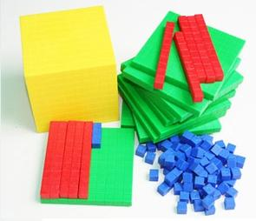
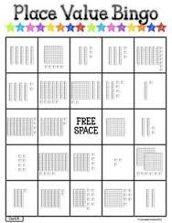
Base Ten

Slide 83
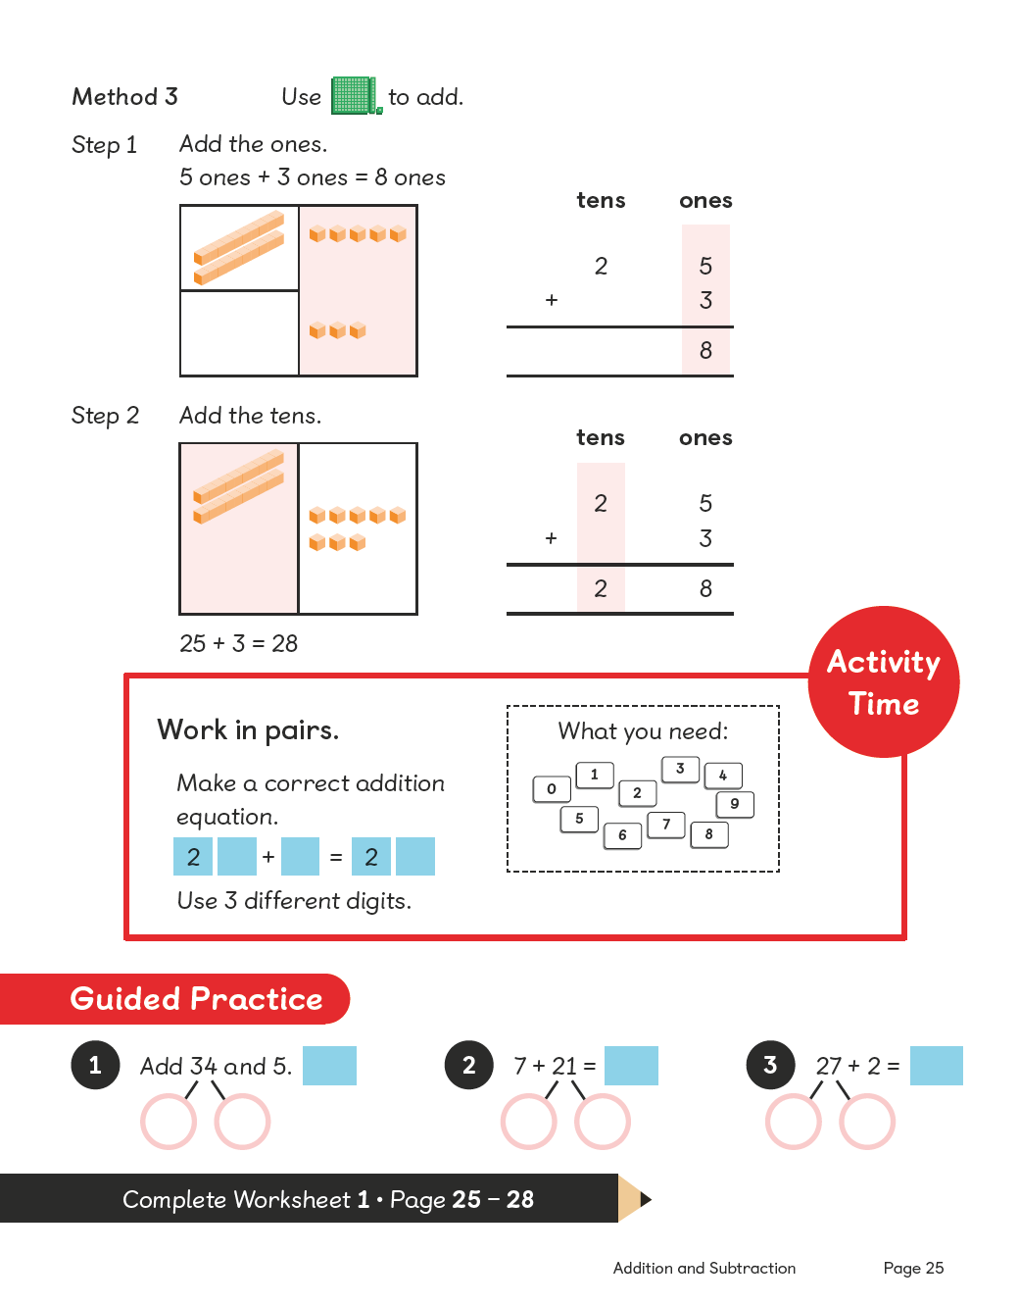

Slide 84
Cuisenaire rods
Notes:
Cuisenaire rods- reference Ronit Bird’s books on these
Dyscalculia Toolkit and Overcoming Difficulties with Number

Slide 85
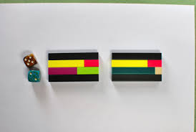
Exploring 7

Slide 86

Fractions

Slide 87
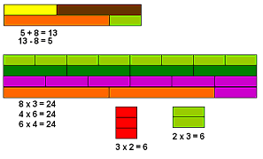
Addition, Subtraction, Multiplication, Division

Slide 88
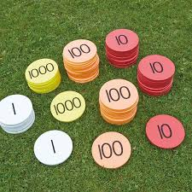
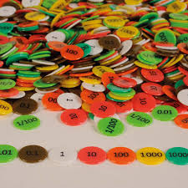
Place value counters

Slide 89
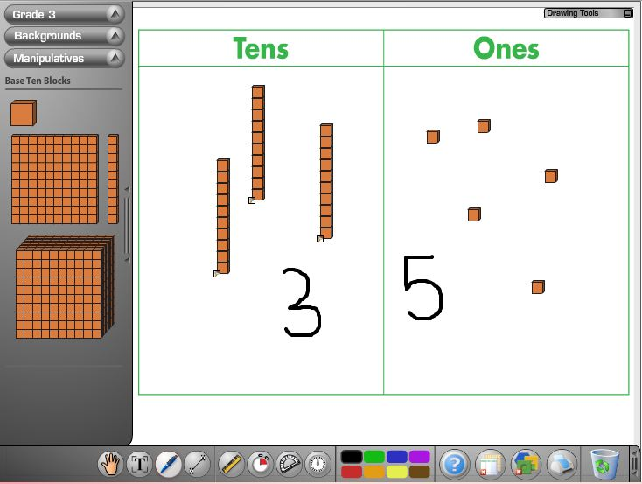
Interactive Manipulatives
http://nlvm.usu.edu/en/nav/vlibrary.html

Slide 90
In Summary
Focus on understanding ( especially of quantity)
Use concrete materials to help link mathematical symbols to quantity
Start at a level which the child is comfortable at, so that they experience some success, and slowly move to more difficult areas
Provide a lot of practice for new skills/concepts
Reduce the need for memorisation, especially initially
Ask a lot of questions to get the child engaged and thinking about their own thinking
Make learning as active and fun as possible- a positive experience

Slide 91
References
Joffe, L (1980) Dyslexia and Attainment in school mathematics, Dyslexia Review, 3 (2) 13-18
Chinn, S. T. & Ashcroft, J. R. (1999) Mathematics for Dyslexics: a teaching handbook. London: Whurr Publishers
Gray, E. M., & Tall D. O. (1991). Duality, Ambiguity and Flexibility in Successful Mathematical Thinking, Proceedings of PME XIII, Assisi Vol. II 72-79.
Karagiannakis,G. and Cooreman, A. (2014) The Routledge International Handbook of Dyscalculia and Mathematical Learning Difficulties, Chapter 19
Yeo, D (2003) Dyslexia, Dyspraxia and Mathematics. Whurr Publishers

Slide 92
Websites
www.nessy.com
www.bdadyslexia.org.uk
www.annarbor.co.uk
www.mathsnoproblem.co.uk
www.ronitbird.co.uk

Slide 93

Any Questions?

